Slide 1
Bible Reading
Challenge, 2017
Week #17

Slide 2
A Study of Matthew 7:13-14
The 2 Paths
Everyone is not on the same path.
There are more people on the wrong path.
Jackson Heights Bible Reading Challenge Week #17

Slide 3
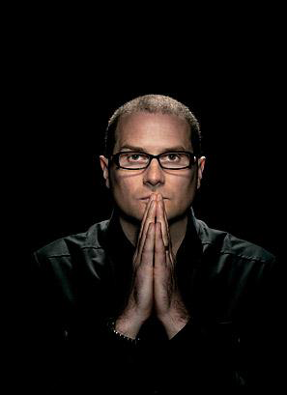

Slide 4
“Enter through the narrow gate; for the gate is wide and the way is broad that leads to destruction, and there are many who enter through it. For the gate is small and the way is narrow that leads to life, and there are few who find it.”
- Matthew 7:13-14
Most people are still on the wrong path…
In spite of the love of God.
In spite of the sacrifice of Jesus.
In spite of the efforts of God’s people.
In spite of heaven.

Slide 5
A Study of Matthew 7:13-14
The 2 Paths
Everyone is not on the same path.
There are more people on the wrong path.
We decide which path we will take.
Jackson Heights Bible Reading Challenge Week #17

