Slide 1
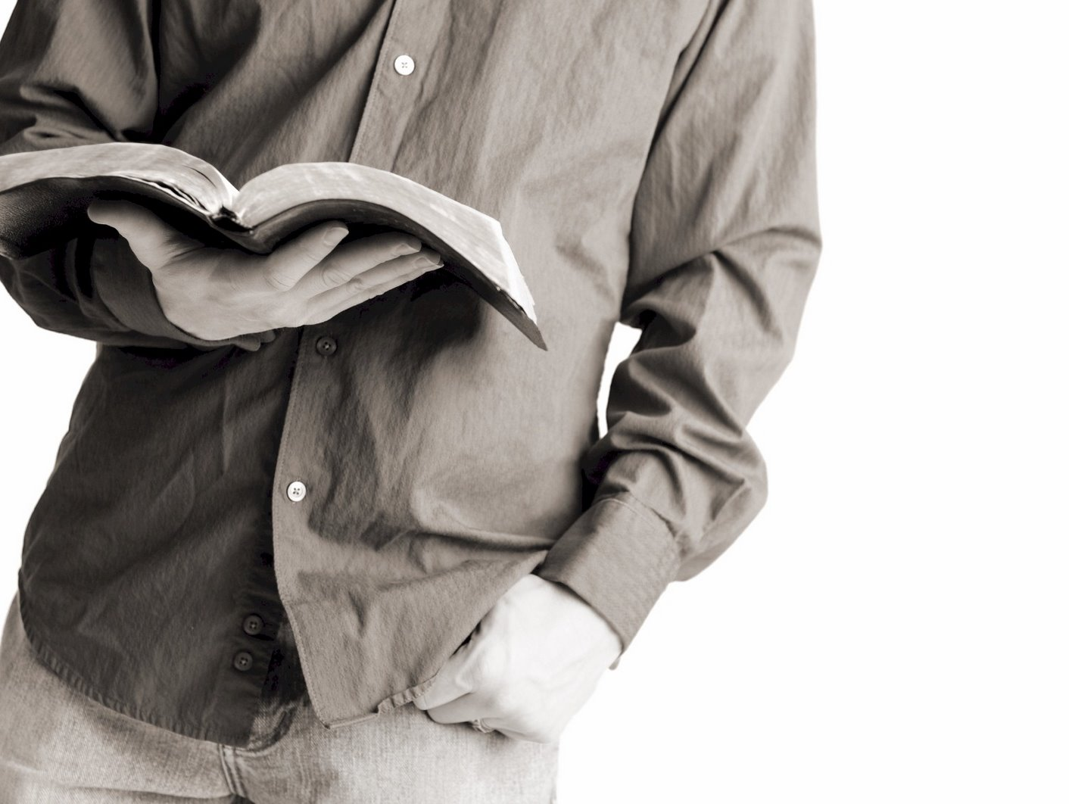
Bible Reading
Challenge, 2017
Week #16

Slide 2
“Remember Jesus Christ, risen from the dead…”
- 2 Timothy 2:8
Jackson Heights Bible Reading Challenge Week #16

Slide 3
What must we remember about the Lord’s resurrection?
1
“Remember Jesus Christ, risen from the dead…”
- 2 Timothy 2:8
It’s Occurrence
Breaking down 1 Corinthians 15:3-8
Jesus died (vs. 3).
Jesus was buried (vs. 4).
Jesus was raised (vs. 4).
Jesus was seen alive (vss. 5-8).
The witnesses were changed by what they saw!
Jackson Heights Bible Reading Challenge Week #16

Slide 4
What must we remember about the Lord’s resurrection?
1
“Remember Jesus Christ, risen from the dead…”
- 2 Timothy 2:8
It’s Occurrence
2
It’s Uniqueness
Jackson Heights Bible Reading Challenge Week #16

Slide 5
Other Cases of Resurrection
Lazarus (John 11)
The widow from Zarephath’s son (1 Kings 17:17-24)
The Shunammite woman’s son (2 Kings 4:32-37)
Dorcas (Acts 9:36-42)
Eutychus (Acts 20:9-10)
Saints in Jerusalem (Matthew 27:52)
“Remember Jesus Christ, risen from the dead…”
- 2 Timothy 2:8
Jackson Heights Bible Reading Challenge Week #16

Slide 6
What must we remember about the Lord’s resurrection?
1
“Remember Jesus Christ, risen from the dead…”
- 2 Timothy 2:8
It’s Occurrence
2
It’s Uniqueness
It was predicted.
He was raised never to die again.
It verifies His identity.
It verifies His teaching.
Jackson Heights Bible Reading Challenge Week #16

Slide 7
What must we remember about the Lord’s resurrection?
1
“Remember Jesus Christ, risen from the dead…”
- 2 Timothy 2:8
It’s Occurrence
2
It’s Uniqueness
3
It’s Significance
Jackson Heights Bible Reading Challenge Week #16

Slide 8
What if Jesus was not raised?
(1 Corinthians 15:12-19)
“Remember Jesus Christ, risen from the dead…”
- 2 Timothy 2:8
Preaching the gospel is worthless (vs. 14).
Our faith is worthless (vs. 14).
The apostles are false witnesses (vs. 15).
We are still in our sins (vs. 17).
“Those who have fallen asleep in Christ have perished (vs. 18).”
“We are of all men most to be pitied (vs. 19).”
Jackson Heights Bible Reading Challenge Week #16

Slide 9
But since Christ has been raised….
“Remember Jesus Christ, risen from the dead…”
- 2 Timothy 2:8
Preaching the gospel is meaningful.
Our faith is priceless.
The apostles were telling the truth.
We can receive forgiveness from God.
Those who have died in Christ have not perished.
We ought to be envied by the world!
Jackson Heights Bible Reading Challenge Week #16

Slide 10
“Remember Jesus Christ, risen from the dead…”
- 2 Timothy 2:8
Jackson Heights Bible Reading Challenge Week #16

