Slide 1
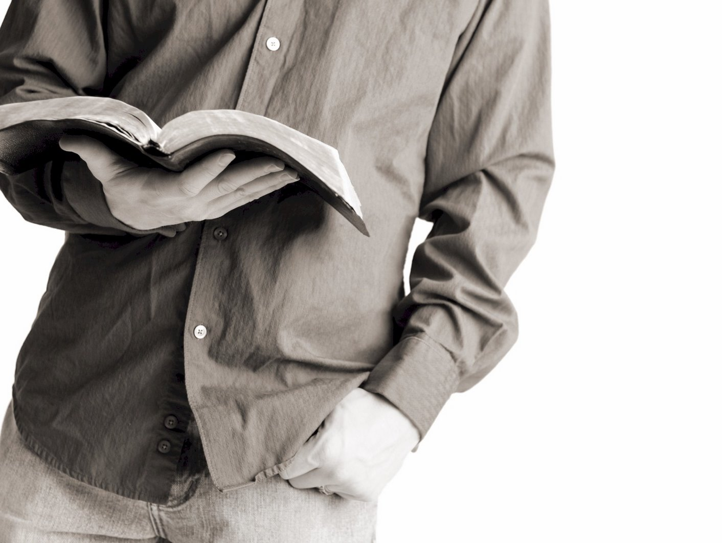
Bible Reading
Challenge, 2017
Week #10

Slide 2
Luke 17:32
Jackson Heights Bible Reading Challenge Week #10

Slide 3
“Remember Lot’s Wife”
Remember her disobedience.
Remember her righteous husband.
Remember how she died outside the city.
Remember that her heart was not with God.
Luke 17:32
Jackson Heights Bible Reading Challenge Week #10

Slide 4
Luke 17:32
Jackson Heights Bible Reading Challenge Week #10

