Slide 1
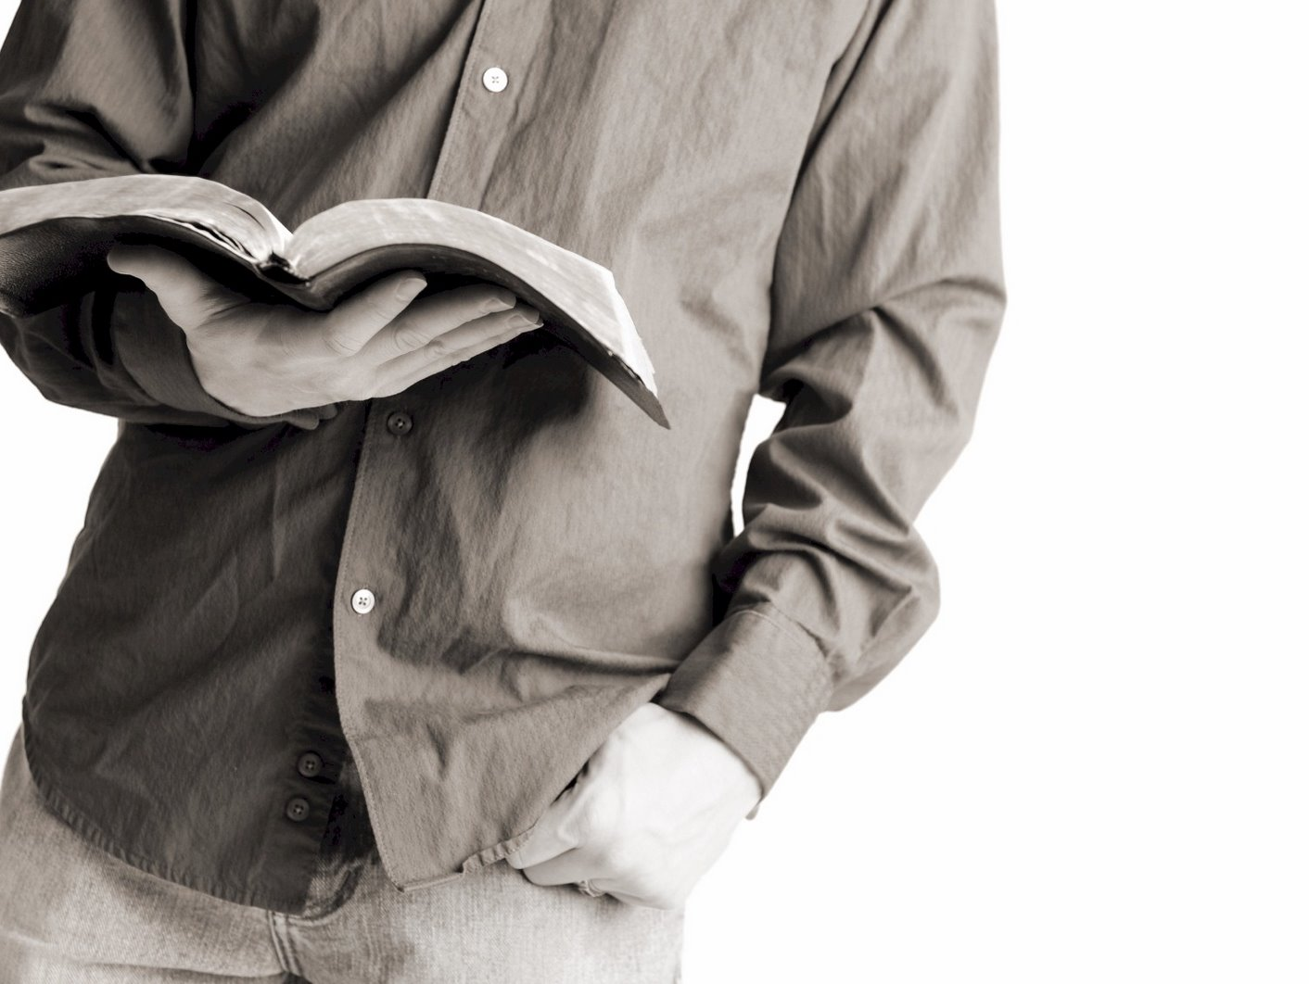
Bible Reading
Challenge, 2017
Week #6

Slide 2
All in Worship
What do we need?
Desire
This is the best place to be because we get to…
Worship our Provider.
Be with the best People.
Receive the best Provisions.
Why shouldn’t I want to be here to experience these blessings?
Jackson Heights Bible Reading Challenge Week #6

Slide 3
All in Worship
What do we need?
Desire
Passion
According to John 4:24, we must worship in…
In truth.
In spirit.
Jackson Heights Bible Reading Challenge Week #6

Slide 4
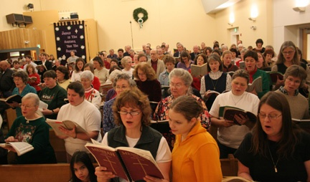
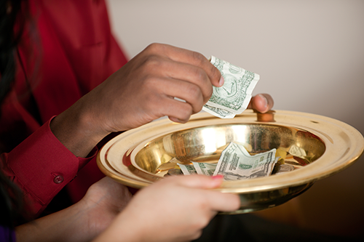
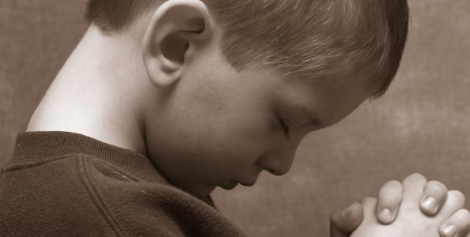
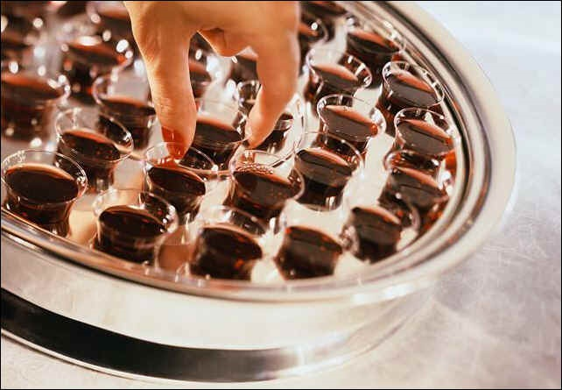
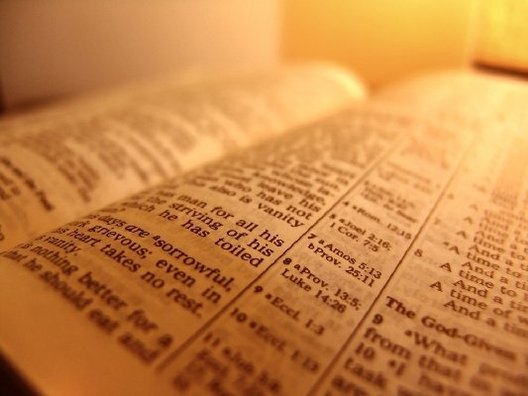
TWO MINUTES
Until Worship Begins
We must worship with our hearts!
PLEASE TAKE YOUR SEAT
PLEASE TAKE YOUR SEAT
PLEASE TAKE YOUR SEAT
PLEASE TAKE YOUR SEAT
PLEASE TAKE YOUR SEAT
PLEASE TAKE YOUR SEAT
PLEASE TAKE YOUR SEAT
PLEASE TAKE YOUR SEAT

Slide 5
All in Worship
What do we need?
Desire
Passion
Reverence
God is greatly to be feared in the assembly of the saints, and to be held in reverence by all those around Him.
- Psalm 89:7
Right now we are in the presence of the King!
Jackson Heights Bible Reading Challenge Week #6

Slide 6
All in Worship
What do we need?
Desire
Passion
Reverence
Are you all in?
Jackson Heights Bible Reading Challenge Week #6

