Slide 2
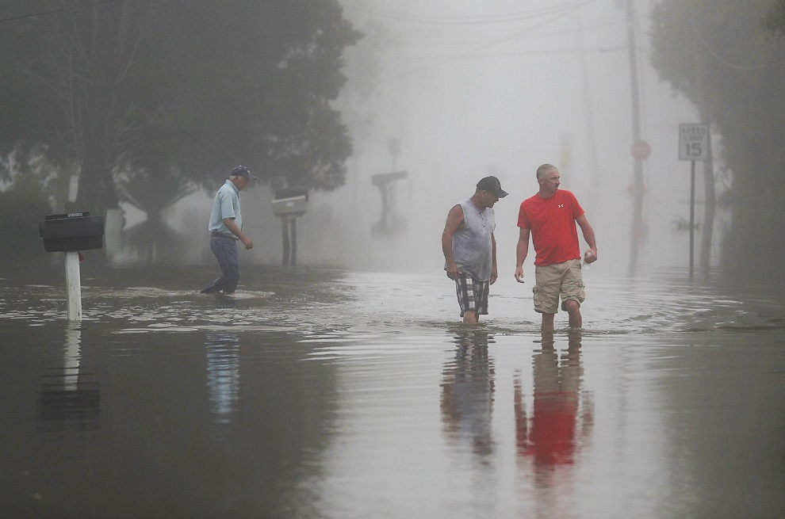

Slide 3
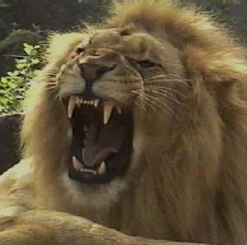
THE DEVIL IS…
YOUR GREATEST THREAT!
He is real.
He is mentioned in the beginning (Genesis 3:1-5).
He is mentioned in the life of David (1 Chronicles 21:1).
He is mentioned in the life of Job (Job 1:7-22).
He is mentioned in the gospels (Matthew 12:26; 16:23; 25:41).
He is mentioned in the epistles (Ephesians 6:12; Jude 9).
“Be of sober spirit, be on the alert. Your adversary, the devil prowls around like a roaring lion, seeking someone to devour.”
– 1 Peter 5:8

Slide 4
THE DEVIL IS…
YOUR GREATEST THREAT!
He is real.
He is not God.
He does not possess unlimited knowledge (Job 1:11).
He is not omnipresent (James 4:7).
He is not all-powerful (Luke 22:31; 1 Corinthians 10:13).
He is not someone who has neither a beginning or end.
“Be of sober spirit, be on the alert. Your adversary, the devil prowls around like a roaring lion, seeking someone to devour.”
– 1 Peter 5:8

Slide 5
THE DEVIL IS…
YOUR GREATEST THREAT!
He is real.
He is not God.
He is powerful.
He has intelligence.
He has memory.
He has desire.
He is your adversary.
He is evil.
He is a liar.
He can be your father.
“Be of sober spirit, be on the alert. Your adversary, the devil prowls around like a roaring lion, seeking someone to devour.”
– 1 Peter 5:8

Slide 6
THE DEVIL IS…
YOUR GREATEST THREAT!
How do we defeat the devil?
We must know the word of God.
We must trust the word of God.
We must obey the word of God.
“Resist the devil and he will flee from you.”
- James 4:7
“Be of sober spirit, be on the alert. Your adversary, the devil prowls around like a roaring lion, seeking someone to devour.”
– 1 Peter 5:8

