Slide 2
Failed Predictions for the End:
1. 50 AD
500 AD
1000 AD
1600 AD
1843-1844
1914
1975
1988
1989
2000
2011
2012
April 2014-September 2015
And as He was sitting on the Mount of Olives, the disciples came to Him privately, saying, “Tell us, when will these things be, and what will be the sign of Your coming, and of the end of the age?”
Matthew 24:3

Slide 3
New Predictions:
1. 2020
2021
2026
2060
2120
2129
And as He was sitting on the Mount of Olives, the disciples came to Him privately, saying, “Tell us, when will these things be, and what will be the sign of Your coming, and of the end of the age?”
Matthew 24:3
For 2,000 years men have been trying to predict the end of the world!
Each time they have been wrong!

Slide 4
Why do the date-setters keep getting it wrong?
They are abusing the scriptures.
And as He was sitting on the Mount of Olives, the disciples came to Him privately, saying, “Tell us, when will these things be, and what will be the sign of Your coming, and of the end of the age?”
Matthew 24:3

Slide 5
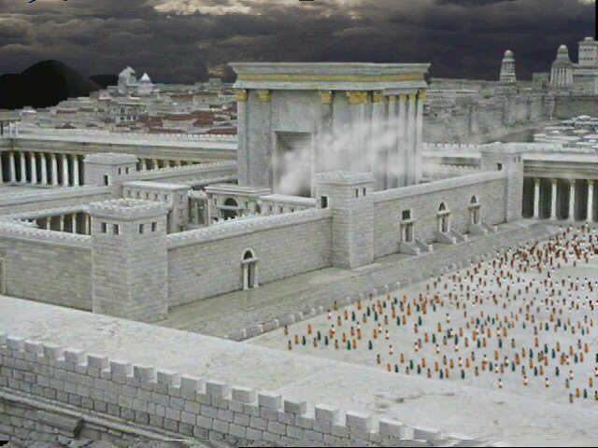
Several Warning Signs of Jerusalem’s Coming Destruction
(Matthew 24:4-14)
False christs
Wars and rumors of wars
Earthquakes and famines
Nation against nation
Kingdom against kingdom
Persecution and betrayals
False prophets
The context: Matthew 24:1-3

Slide 6
Why do the date-setters keep getting it wrong?
They are abusing the scriptures.
They are trying to do the impossible.
And as He was sitting on the Mount of Olives, the disciples came to Him privately, saying, “Tell us, when will these things be, and what will be the sign of Your coming, and of the end of the age?”
Matthew 24:3
But of that day and hour no one knows, not even the angels of heaven, nor the Son, but the Father alone.
Matthew 24:36

Slide 7
Date-Setters are trying to do something that can’t be done!
The Bible does not give a date for the end of the world!
The Bible does not tell us how to calculate a date!
There are no signs which will indicate that the end is near!
And as He was sitting on the Mount of Olives, the disciples came to Him privately, saying, “Tell us, when will these things be, and what will be the sign of Your coming, and of the end of the age?”
Matthew 24:3

Slide 8
What you need to know about the end:
It will occur.
It will occur when Jesus returns.
There is no exact date given in the Bible.
The dead will be raised and every person will be judged.
Those caught unprepared will be in trouble.
And as He was sitting on the Mount of Olives, the disciples came to Him privately, saying, “Tell us, when will these things be, and what will be the sign of Your coming, and of the end of the age?”
Matthew 24:3

Slide 9
If the world ended today, would you be prepared?
Have you believed in Jesus (John 8:24)?
Have you repented (Acts 17:30-31)?
Have you been baptized for the remission of your sins (Acts 2:38)?
If so, are you living faithful before the Lord (2 Peter 3:11-14)?

Slide 10
You can’t know when the world will end…
But you can make sure you are ready if it occurred today!

