Slide 2
THE CONTEXT OF DANIEL 2:31-45
Daniel has been taken into Babylonian captivity (Daniel 1:1-4).
Daniel refused to compromise his faith (Daniel 1:5-8).
God blessed Daniel with great intelligence and the ability to interpret dreams and visions (Daniel 1:17). This would be extremely helpful to him in the future!
King Nebuchadnezzar received a dream from God that he wanted to know the meaning of (Daniel 2:1-3).
Only Daniel could give its meaning (Daniel 2:24).

Slide 3
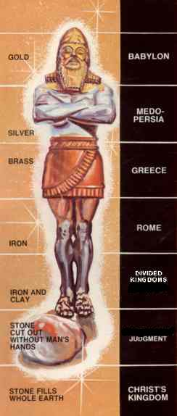
THE INTERPRETATION OF THE KING’S DREAM
GOLD
BABYLON
626 BC
MEDO-PERSIA
539 BC
SILVER
BRASS
GREECE
331 BC
ROME
63 BC
IRON
Division within Rome
IRON & CLAY

Slide 4
THE INTERPRETATION OF THE KING’S DREAM
GOLD
BABYLON
626 BC
MEDO-PERSIA
539 BC
SILVER
BRASS
GREECE
331 BC
ROME
63 BC
IRON
Division within Rome
IRON & CLAY

Slide 5
THE INTERPRETATION OF THE KING’S DREAM
GOLD
BABYLON
626 BC
MEDO-PERSIA
539 BC
SILVER
BRASS
GREECE
331 BC
ROME
63 BC
IRON
Division within Rome
IRON & CLAY

Slide 6
THE INTERPRETATION OF THE KING’S DREAM
GOLD
BABYLON
626 BC
MEDO-PERSIA
539 BC
SILVER
BRASS
GREECE
331 BC
ROME
63 BC
IRON
Division within Rome
IRON & CLAY

Slide 7
THE INTERPRETATION OF THE KING’S DREAM
GOLD
BABYLON
626 BC
MEDO-PERSIA
539 BC
SILVER
BRASS
GREECE
331 BC
ROME
63 BC
IRON
Division within Rome
IRON & CLAY

Slide 8
THE INTERPRETATION OF THE KING’S DREAM
The 5th Kingdom (Daniel 2:44-45)
GOLD
BABYLON
626 BC
Established during the time of the 4th kingdom.
It would last forever!
It would be like a stone cut out without human hands.
It would be like a great mountain that filled the earth.
MEDO-PERSIA
539 BC
SILVER
BRASS
GREECE
331 BC
ROME
63 BC
IRON
Division within Rome
The 5th kingdom is the Lord’s kingdom!
IRON & CLAY

Slide 9
3 LESSONS ABOUT GOD
God has the power to predict the future!
God has the power to reign!
God has the power to save!
GOLD
BABYLON
626 BC
MEDO-PERSIA
539 BC
SILVER
BRASS
GREECE
331 BC
Are you a citizen in the 5th kingdom?
ROME
63 BC
IRON
Division within Rome
The 5th kingdom is the Lord’s kingdom!
IRON & CLAY

