Slide 2
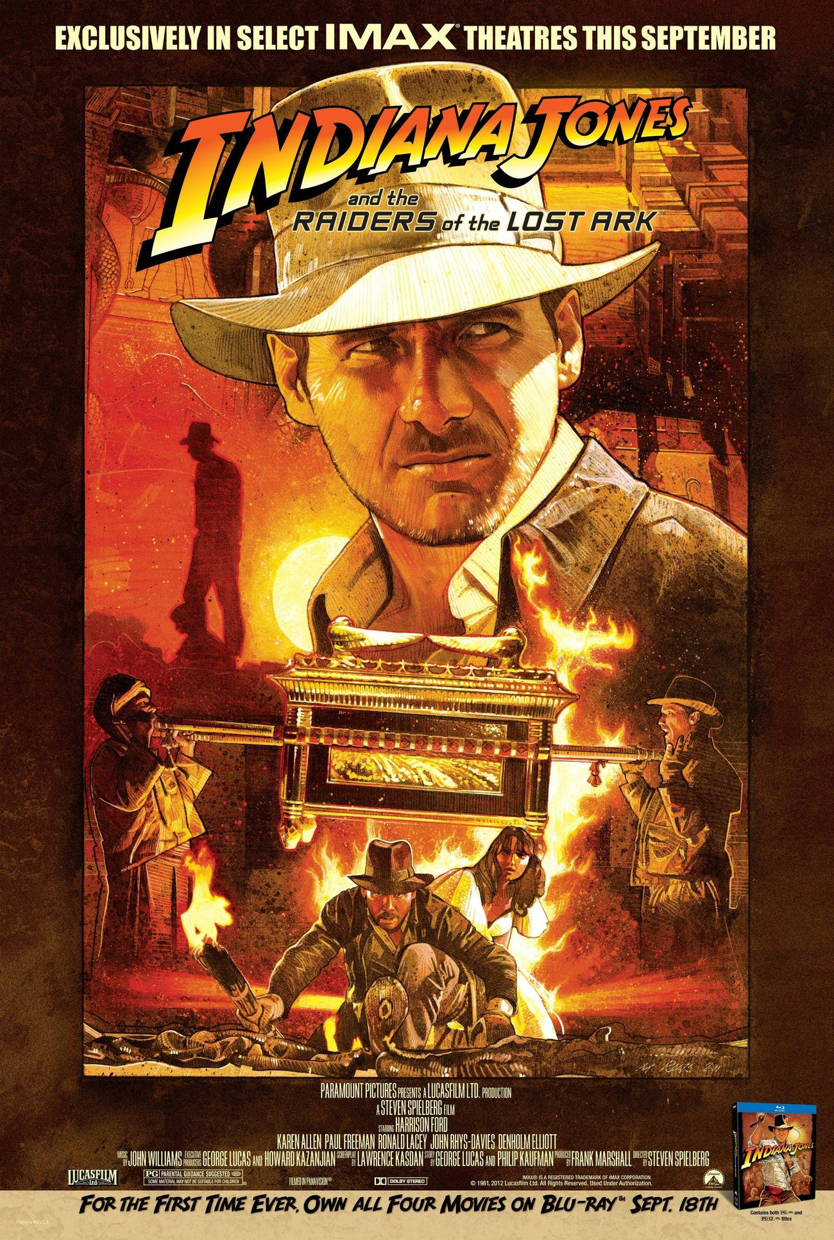

Slide 3
What do you know about it?

Slide 4
Fast Facts:
It is mentioned as early as Exodus 25:8-10.
It was part of the tabernacle’s furnishings.
It was the most sacred item among the people of Israel.
It was a box designed by God.
It was made of acacia wood and completely covered in gold.
Above it were two cherubim and a covering called “the mercy seat.”
It had golden rings and poles.
Only the sons of Kohath could move it (but not touch it).

Slide 5
Fast Facts:
God killed Uzzah because he touched the ark.
God wanted it to be a symbol of His presence and power.
It was placed in the most holy place in the tabernacle and temple.
In the days of Eli and Samuel it was housed in Shiloh.
The Philistines took it from Israel in battle (1 Samuel 4:1-21).
The Philistines suffered when they possessed it (1 Samuel 5:1-12).
The Philistines returned it to Bethshemesh (1 Samuel 6:11-12).
Many in Bethshemesh were killed because they tried to look into it.

Slide 6
What was in the ark?
Manna from Heaven
Aaron’s Rod that Budded
Tablets of stone – The 10 Commandments

Slide 7
What was in the ark?
Manna from Heaven (a reminder of God’s care)
Aaron’s Rod that Budded
Tablets of stone – The 10 Commandments

Slide 8
What was in the ark?
Manna from Heaven (a reminder of God’s care)
Aaron’s Rod that Budded (a reminder of God’s choices)
Tablets of stone – The 10 Commandments

Slide 9
What was in the ark?
Manna from Heaven (a reminder of God’s care)
Aaron’s Rod that Budded (a reminder of God’s choices)
Tablets of stone – The 10 Commandments (a reminder of God’s commandments)

Slide 10
What about us?
Manna from Heaven
Aaron’s Rod that Budded
Tablets of stone – The 10 Commandments

Slide 11
What about us?
Manna from Heaven Jesus is the bread of life!
Aaron’s Rod that Budded
Tablets of stone – The 10 Commandments

Slide 12
What about us?
Manna from Heaven Jesus is the bread of life!
Aaron’s Rod that Budded Jesus is the ultimate leader!
Tablets of stone – The 10 Commandments

Slide 13
What about us?
Manna from Heaven Jesus is the bread of life!
Aaron’s Rod that Budded Jesus is the ultimate leader!
Tablets of stone – The 10 Commandments Jesus is the word of God!

