Slide 2
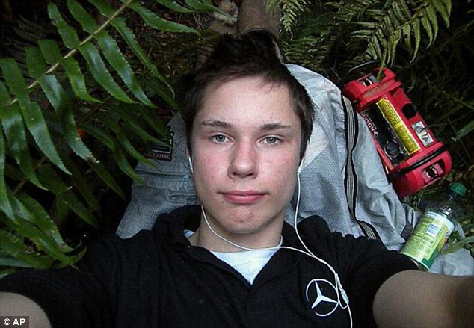
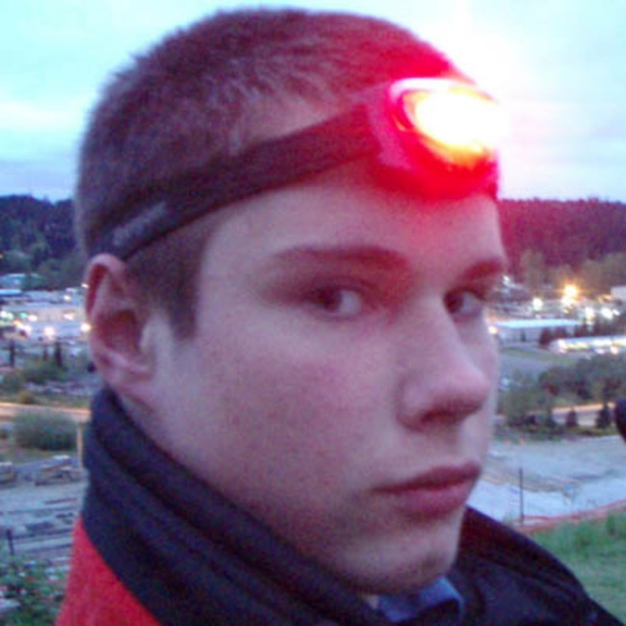
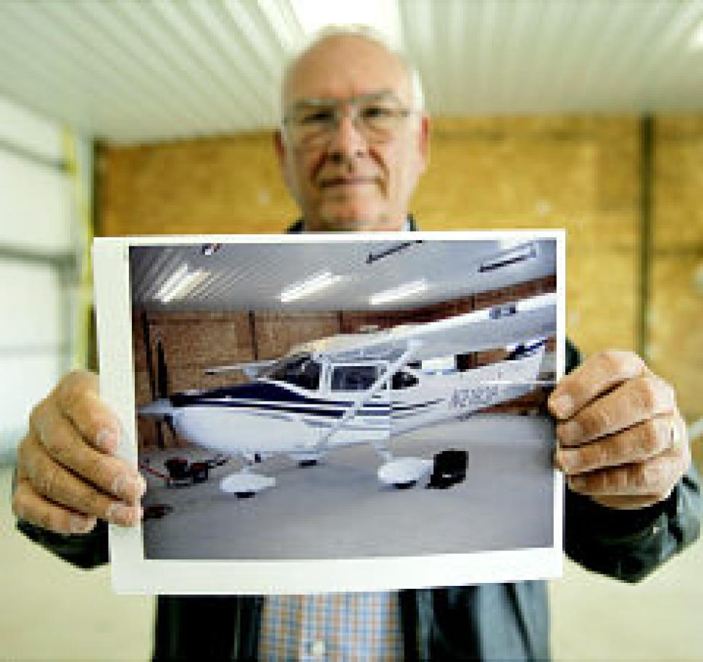
“The Barefoot Bandit”

Slide 3
Do not we live in a society where many people minimize sin?

Slide 4
How God Sees Sin
Sin is real.
Sin is bad!
You are not a God who takes pleasure in wickedness, nor shall evil dwell with You.
- Psalm 5:4

Slide 5
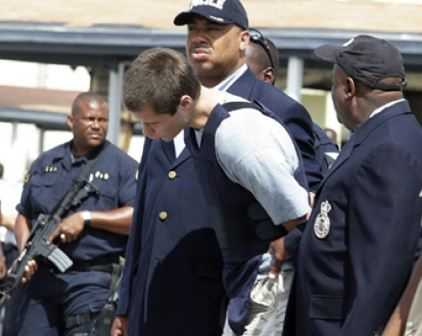

Slide 6
How God Sees Sin
Sin is real.
Sin is bad!
It damages our relationship with God.
It cuts us off from God.
It hinders our prayers.
It brings about God’s judgment.

Slide 7
How God Sees Sin
Sin is real.
Sin is bad!
Sin hurts…
God!

Slide 8
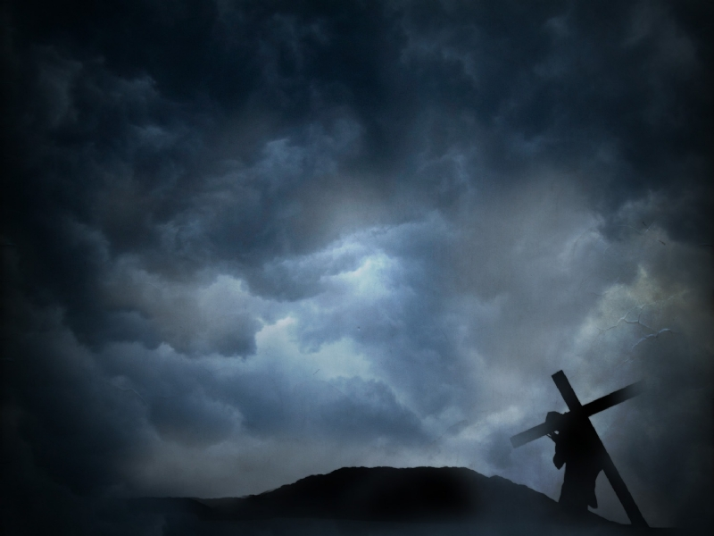
The seriousness of sin can be seen fully by looking at the…
Cross.
But He was wounded for our transgressions, He was bruised for our iniquities; the chastisement for our peace was upon Him, and by His stripes we are healed.
- Isaiah 53:5

