Slide 2
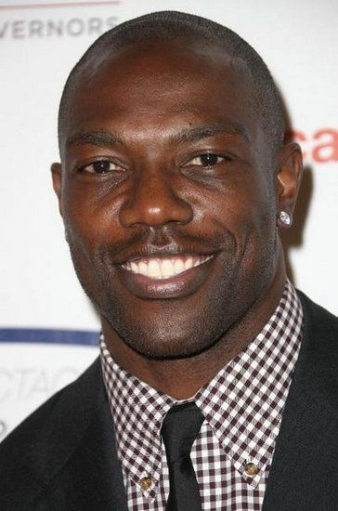
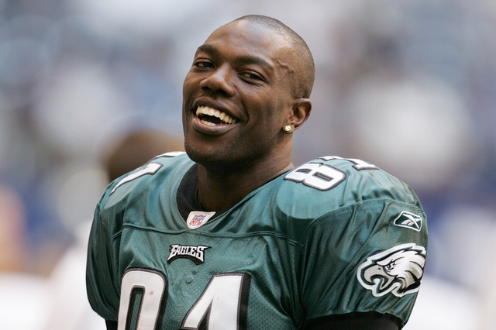
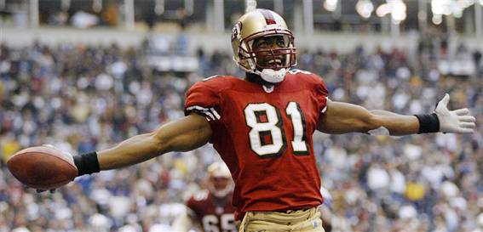
“I LOVE ME SOME ME!”

Slide 3
What about us?

Slide 4
A Proper View of Ourselves
”For by the grace given me I say to every one of you: Do not think of yourself more highly than you ought,”
- Romans 12:3
Case Studies:
King Nebuchadnezzar (Daniel 4:28-30)
He thought he was self-sufficient.
The Apostles (Luke 22:34; Mark 10:35-41)
They were in constant competition.
The Lord Jesus
He was a servant (Mark 10:45).

Slide 5
A Proper View of Ourselves
”For by the grace given me I say to every one of you: Do not think of yourself more highly than you ought,”
- Romans 12:3
How do we achieve this?
Remember who we are (Romans 12:4-5)
- God’s creation (Genesis 1:26)
- God’s children (2 Corinthians 5:17)
- Created to serve (Romans 12:3-8)

Slide 6
A Proper View of Ourselves
”For by the grace given me I say to every one of you: Do not think of yourself more highly than you ought,”
- Romans 12:3
How do we achieve this?
Remember who we are (Romans 12:4-5)
Remember others (Philippians 2:3-5)
Remember to get our hands dirty (John 13:5)
Remember to have the right motive (1 Corinthians 10:31; 1 Peter 4:11)

Slide 7
A Proper View of Ourselves
”For by the grace given me I say to every one of you: Do not think of yourself more highly than you ought,”
- Romans 12:3
The Blessings:
We will be more like Jesus.
We will be humble.
We will be put on a path to heaven!

Slide 8
M A R K 1 0 : 4 5
For even the Son of Man did not come to be served, but to serve,
and to give His life a ransom for many.

