Slide 1
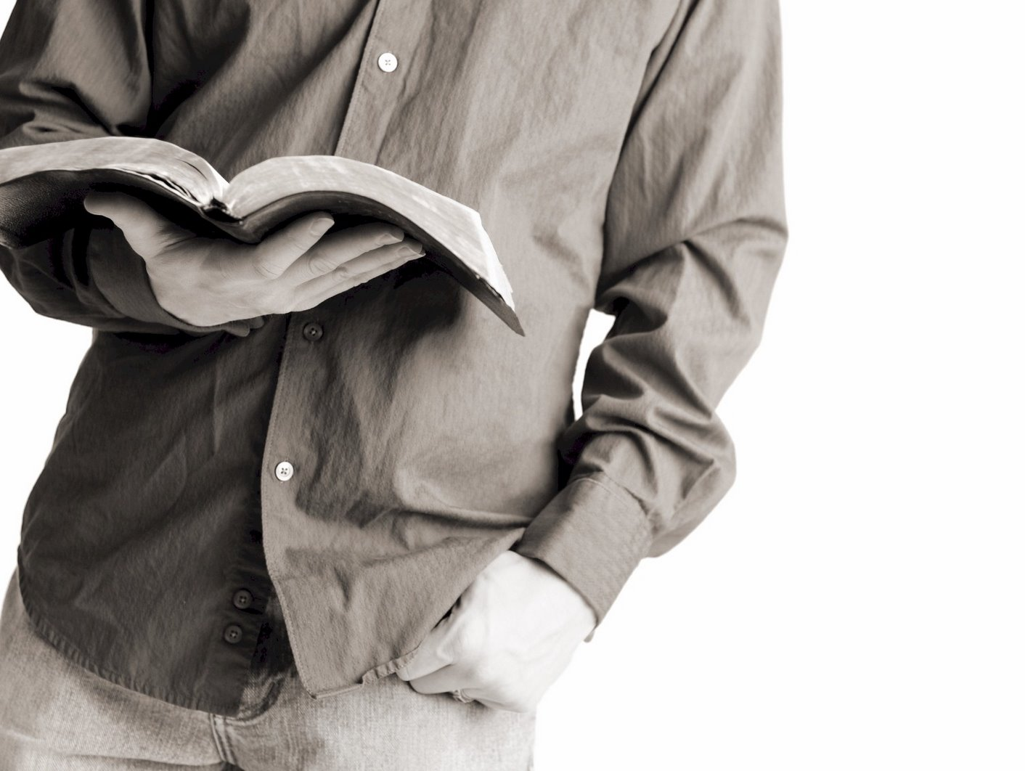
Bible Reading
Challenge, 2017
Week #23

Slide 2
Luke7:11-17

Slide 3
Fear gripped them all, and they began glorifying God, saying, “A great prophet has arisen among us!” and, “God has visited His people!”
- Luke 7:16
Other occasions when God visited His people:
In the days of Moses (Exodus 3:16)
In the days of Ruth (Ruth 1:6)
In the days of Jesus among those in Jerusalem (Luke 19:44)

Slide 4
When God visited….
…His people
What did they see?
An act of compassion (Luke 7:12-13)
This woman is…
a widow.
now going to bury her only son.
accompanied by a large crowd.
Jackson Heights Bible Reading Challenge Week #23

Slide 5
When God visited….
…His people
What did they see?
An act of compassion (Luke 7:12-13)
Does this give us confidence that Jesus can…
Help us?
Raise us?
Save us?
Real Power (Luke 7:14-16)
Jackson Heights Bible Reading Challenge Week #23

Slide 6
When God visited….
…His people
What did they see?
An act of compassion (Luke 7:12-13)
People who are really excited about Jesus and what He has done for them have to tell others!
Real Power (Luke 7:14-16)
Something that needed to be shared (Luke 7:17)
Jackson Heights Bible Reading Challenge Week #23

