Slide 1
Bible Reading
Challenge, 2017
Week #17

Slide 2
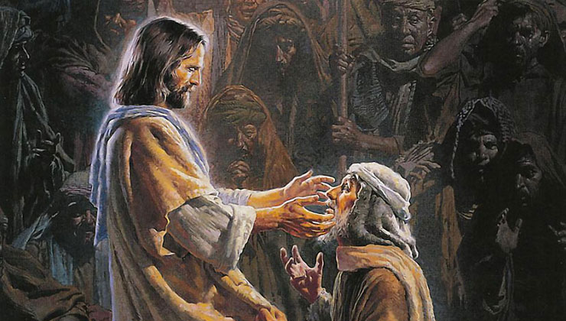
5 Powerful Facts About the Miracles of Jesus
They are a core aspect of the gospel.
They give us insight into the heart of Jesus.
They were instant and recognizable.
They could not be denied by Jesus’ enemies.
They did not always involve faith.
Jackson Heights Bible Reading Challenge Week #17

Slide 3
Final Thoughts about Jesus’ Miracles Miracles
They provide you with supernatural evidence you need to believe in Him.
They show you that Jesus had real power!
You haven’t seen anything like them today!
They should ultimately lead you to being obedient to Jesus.
Jackson Heights Bible Reading Challenge Week #17

