Slide 1
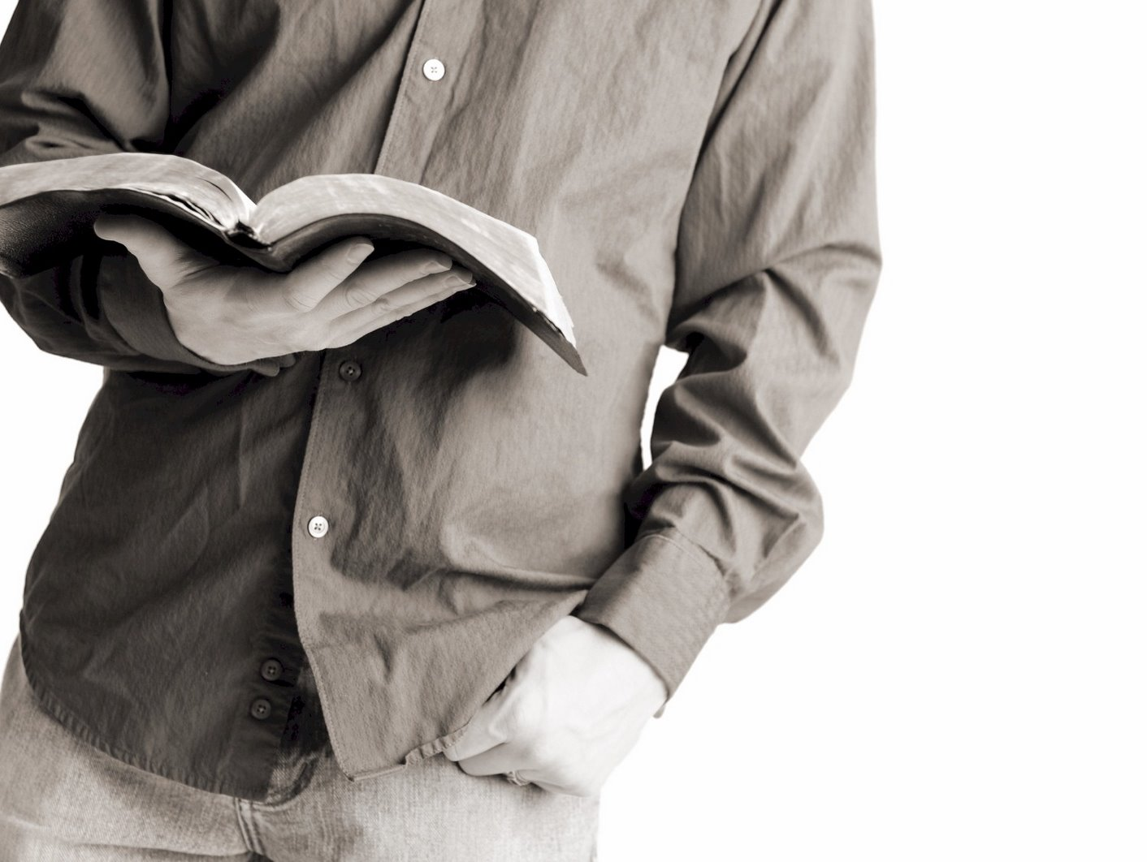
Bible Reading
Challenge, 2017
Week #14

Slide 2
The Obstacle of Rejection
How do we overcome it?
Remember this is not a new obstacle.
Jackson Heights Bible Reading Challenge Week #14

Slide 3
Conversion Success Stories
The people of Nineveh (Jonah 3:5-10)
The 3,000 on Pentecost (Acts 2:38-41)
The church grew to 5,000 men (Act 4:4)
The Samaritans (Acts 8:12)
Simon the Sorcerer (Acts 8:13)
The Ethiopian Treasurer (Acts 8:25-40)

Slide 4
Conversion Success Stories
7. Saul of Tarsus (Acts 9)
8. Cornelius (Act 10)
9. Lydia (Act 16:14-15)
10. The Philippian Jailer (Acts 16:25-34)
11. The Thessalonians (Acts 17:1-4)
12. The Bereans (Acts 17:11-12)
13. The Corinthians (Acts 18:8)
14. The Ephesians (Acts 19:1-5)

Slide 5
Conversion Stories that Did Not Turn Out So Well
The preaching of Noah (2 Peter 2:5).
The preaching of the prophets.
Peter and John are thrown in jail (Acts 4).
All the apostles are thrown in jail (Acts 5).
Stephen is murdered (Acts 7).

Slide 6
Conversion Stories that Did Not Turn Out So Well
6. Paul is stoned in Lystra (Acts 14:19).
7. Paul is forced from Thessalonica (Acts 17:5-10).
A riot starts in Ephesus (Acts 19:23-41).
Felix refuses to obey the gospel (Acts 24:25).
Many disciples left Jesus (John 6:66).

Slide 7
The Obstacle of Rejection
How do we overcome it?
Remember this is a not a new obstacle.
Remember who people are really rejecting.
They are rejecting God!
Jackson Heights Bible Reading Challenge Week #14

Slide 8
The Obstacle of Rejection
How do we overcome it?
Remember this is a not a new obstacle.
Remember who people are really rejecting.
Remember our responsibility.
It is to plant the seed!
Jackson Heights Bible Reading Challenge Week #14

