Slide 1
Bible Reading
Challenge, 2017
Week #15

Slide 2
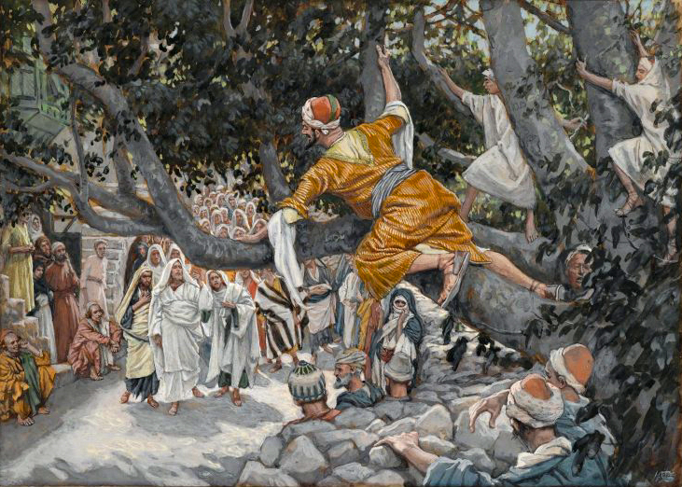

Slide 3
When Zaccheus Meets Jesus (Luke 19:1-10)
Zaccheus’ name means “pure.”
He was a chief tax collector.
He was rich.
He wanted to see Jesus.
He was “small in stature.”
He climbed into a sycamore tree.
Key Observations
Jackson Heights Bible Reading Challenge Week #15

Slide 4
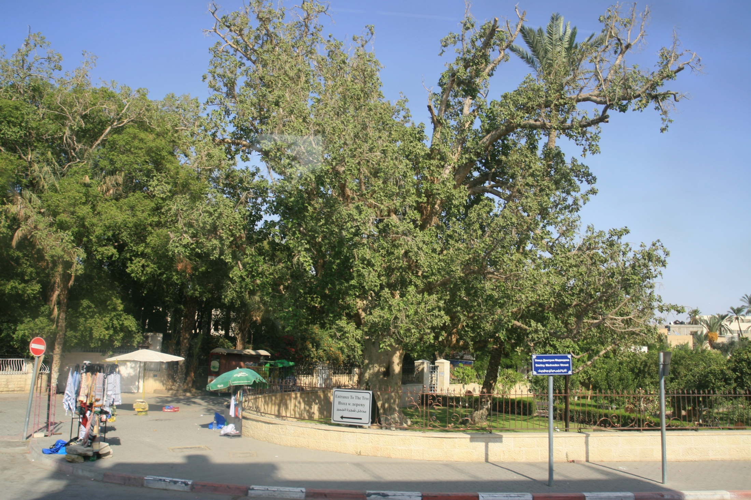
JERICHO

Slide 5
When Zaccheus Meets Jesus (Luke 19:1-10)
Zaccheus’ name means “pure.”
He is a chief tax collector.
He is rich.
He wanted to see Jesus.
He was “small in stature.”
He climbed into a sycamore tree.
Jesus said He must stay in his house.
He gladly received the Lord in his house.
Key Observations
Jackson Heights Bible Reading Challenge Week #15

Slide 6
When Zaccheus Meets Jesus (Luke 19:1-10)
Key Lessons
Jesus knows you!
Jesus wants you!
Jesus can change you!
Jackson Heights Bible Reading Challenge Week #15

