Slide 1
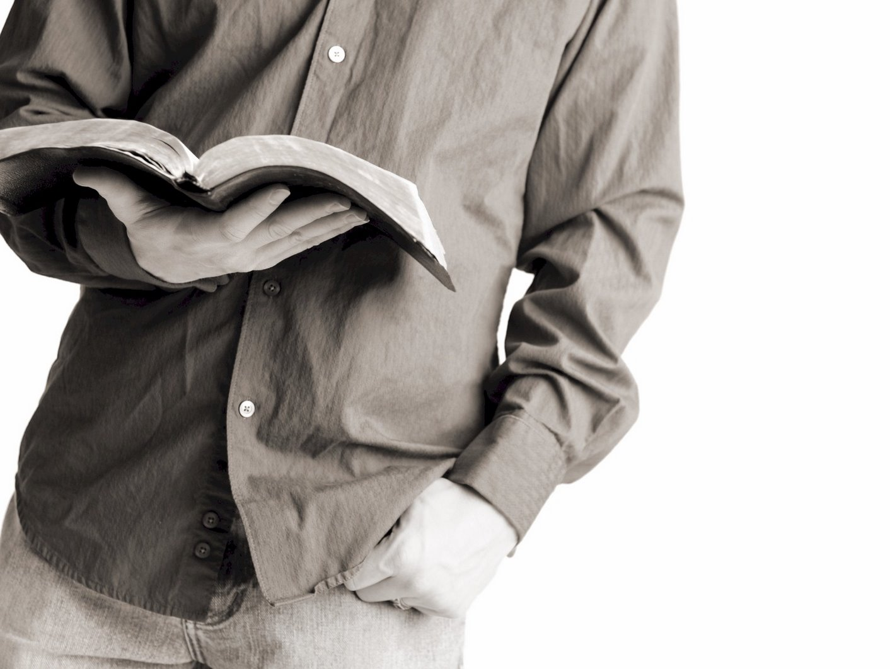
Bible Reading
Challenge, 2017
Week #11

Slide 2
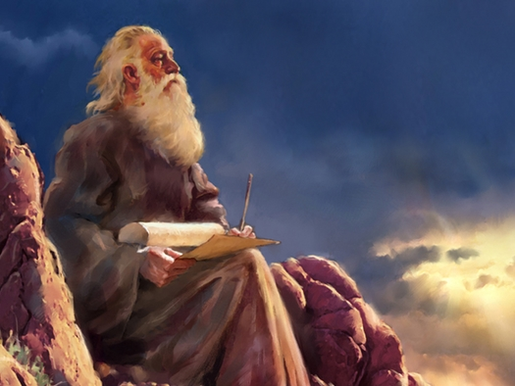
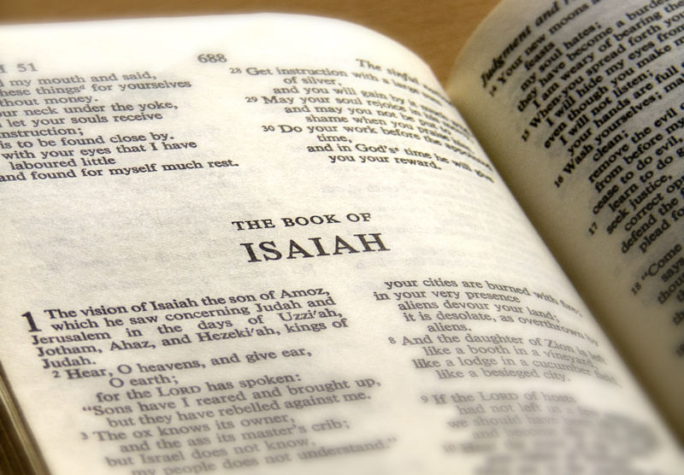
What is a prophet?
He is spokesman for God.
He speaks to people on the behalf of God.
He is a mouthpiece for God.
He speaks as he is inspired by the Holy Spirit.
Jackson Heights Bible Reading Challenge Week #11

Slide 3
Habakkuk’s Conversation with God
Habakkuk: “What will you do about the sins of my people?”
God: “I will use the Chaldeans to punish them.”
Habakkuk: “I don’t like that.”
God: “I am still going to do it.”
God: “But I will also punish the Chaldeans!”
Jackson Heights Bible Reading Challenge Week #11

Slide 4
Habakkuk’s Conversation with God
Lessons:
God knows everything that is going on.
God cares.
God is just.
We must accept God’s will.
We must stick with God no matter what!
Jackson Heights Bible Reading Challenge Week #11

