Slide 1
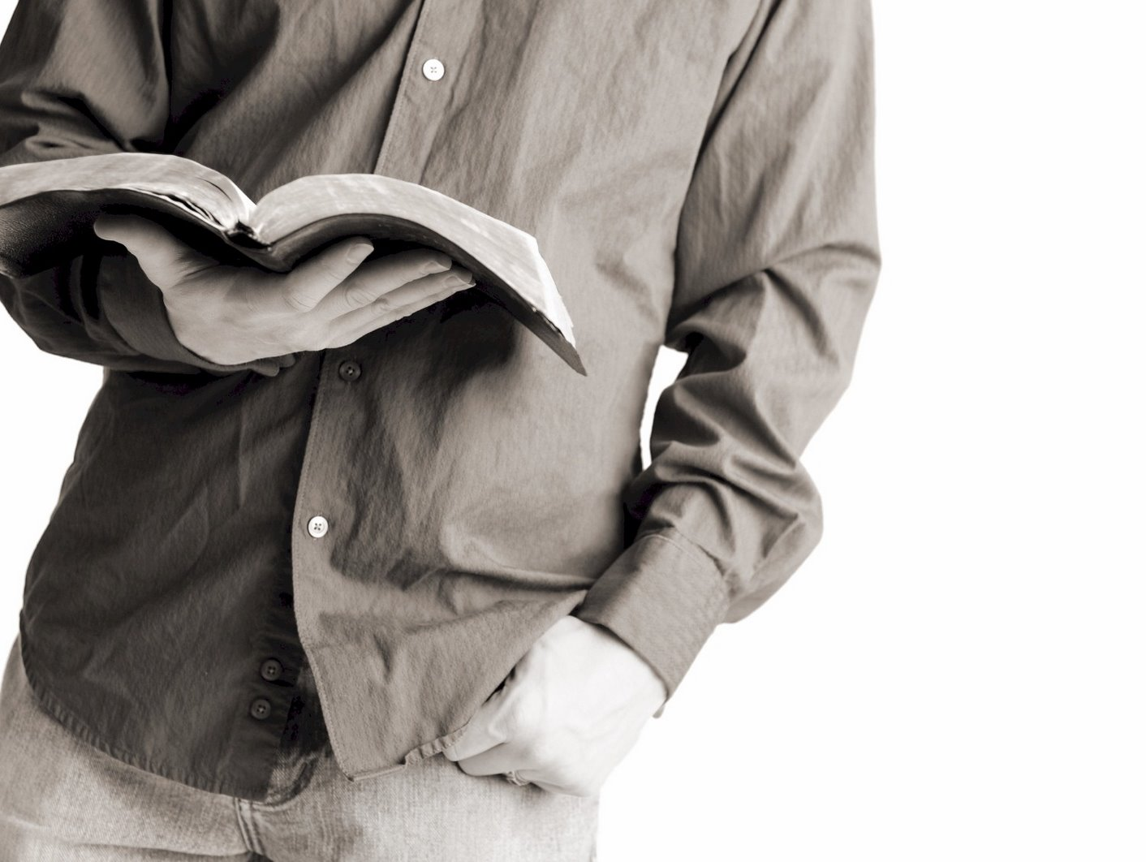
Bible Reading
Challenge, 2017
Week #6

Slide 2
Jesus of Bethlehem
A small town 6 miles southwest of Jerusalem.
Sits on a housetop (2300 feet above sea level).
Mentioned quite a bit in the Old Testament.
Rachel was buried here.
Ibzan was from here.
David was from here.
The Messiah would be born here.

Slide 3
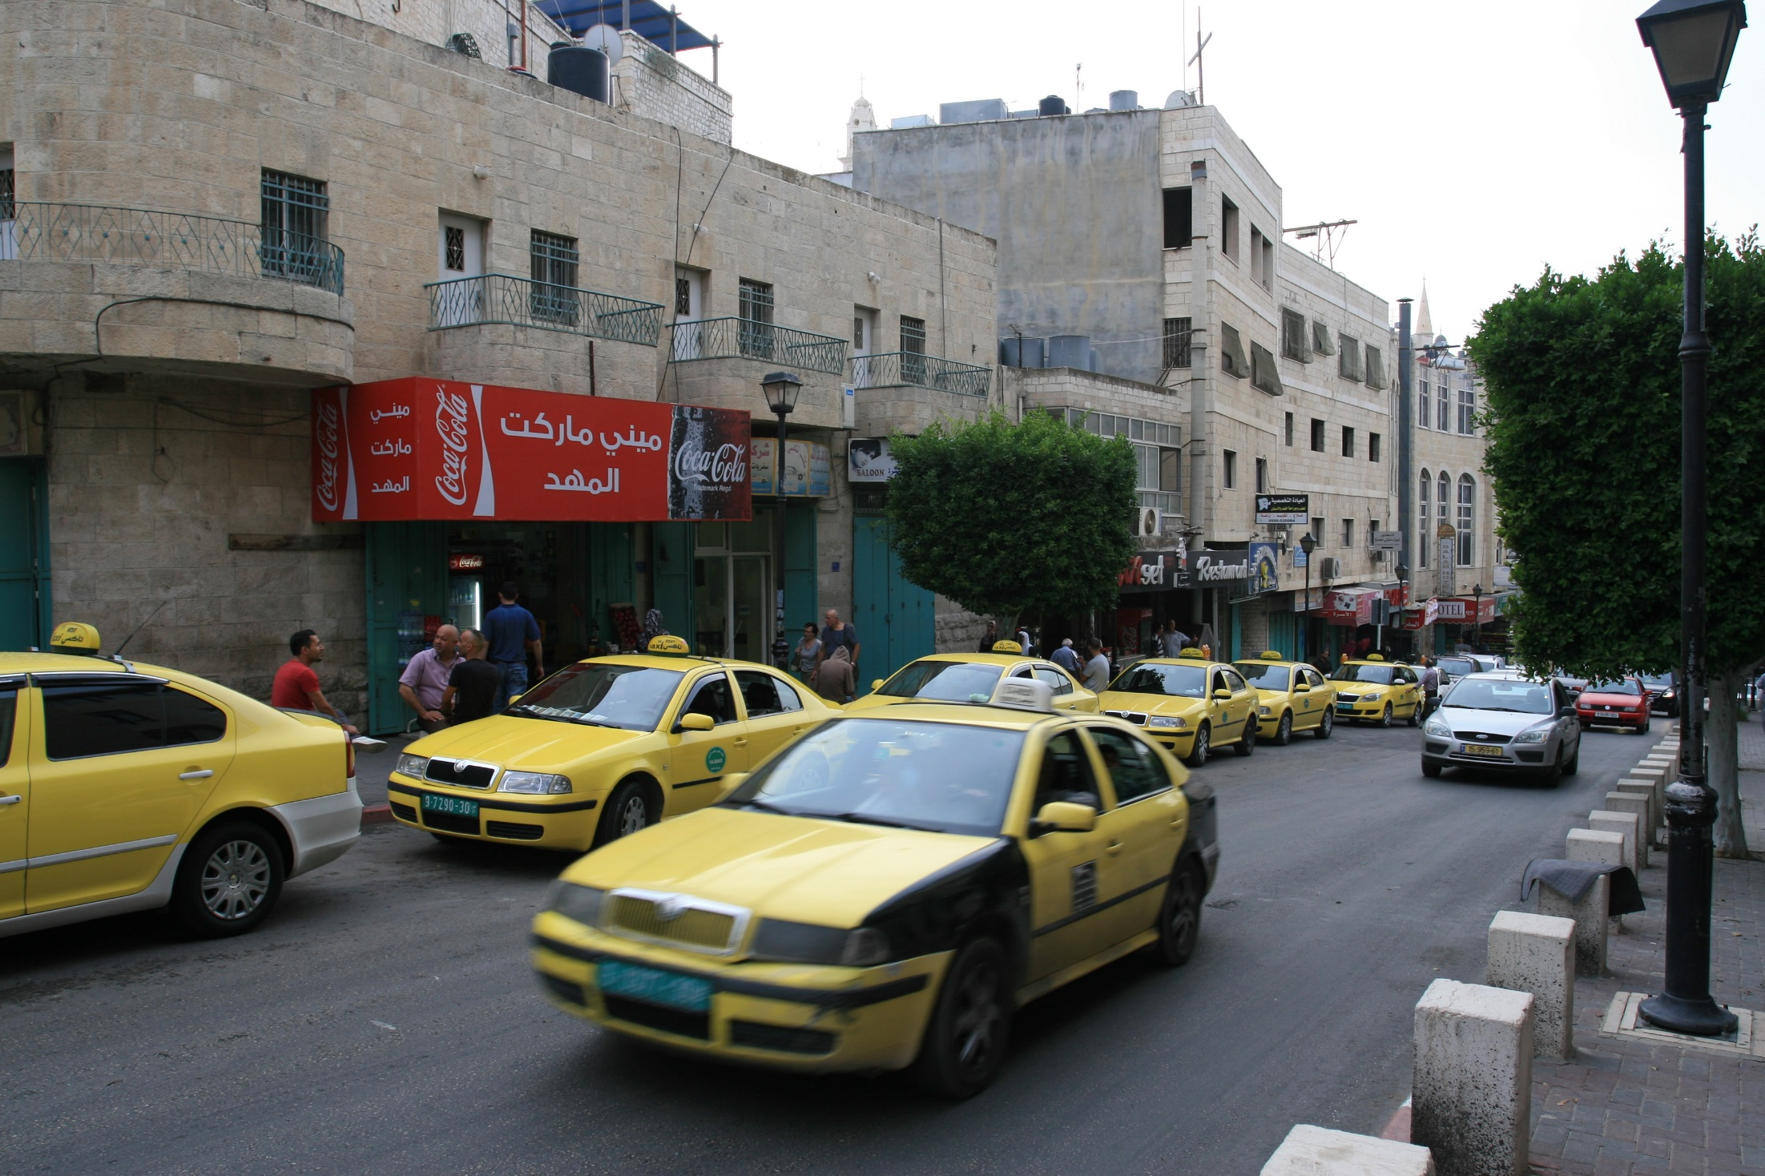

Slide 4
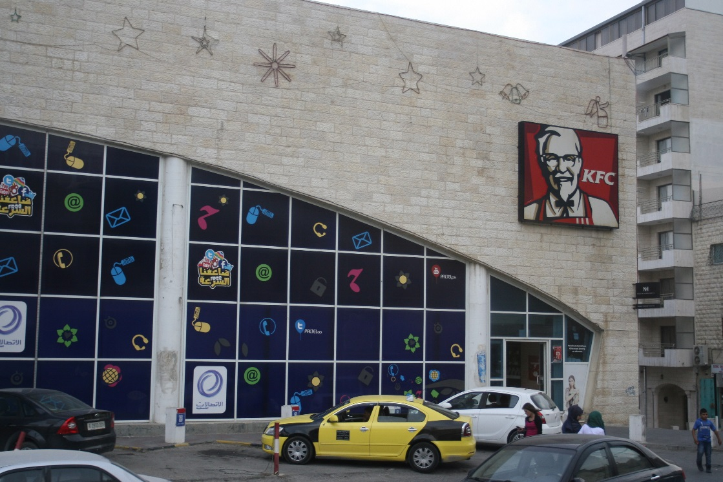
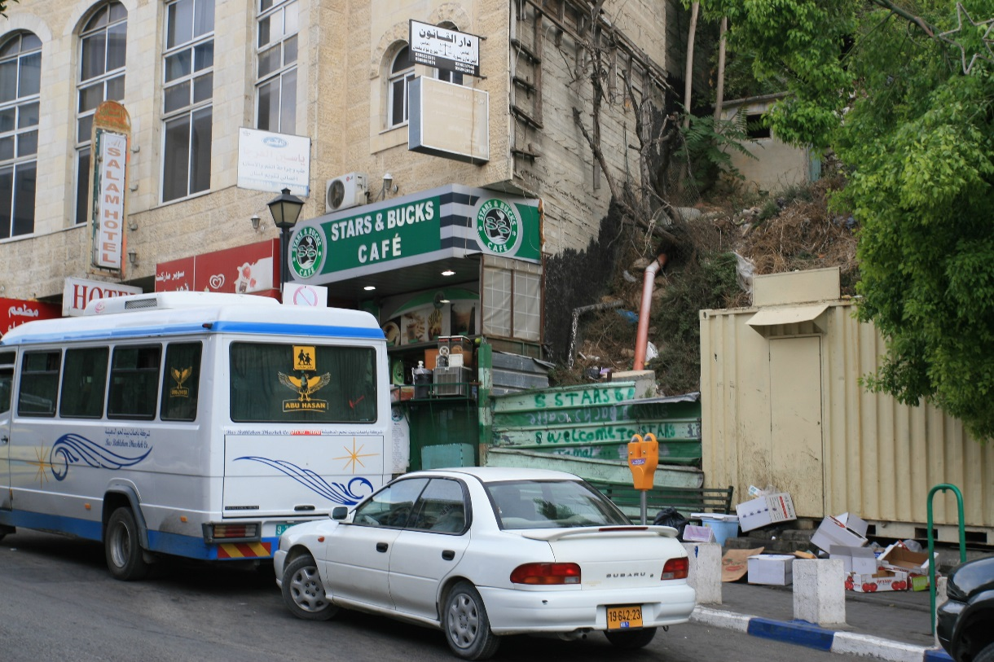

Slide 5
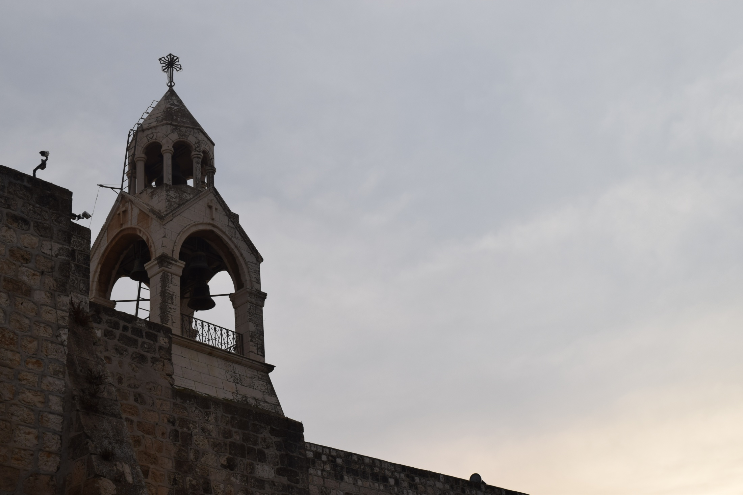

Slide 6
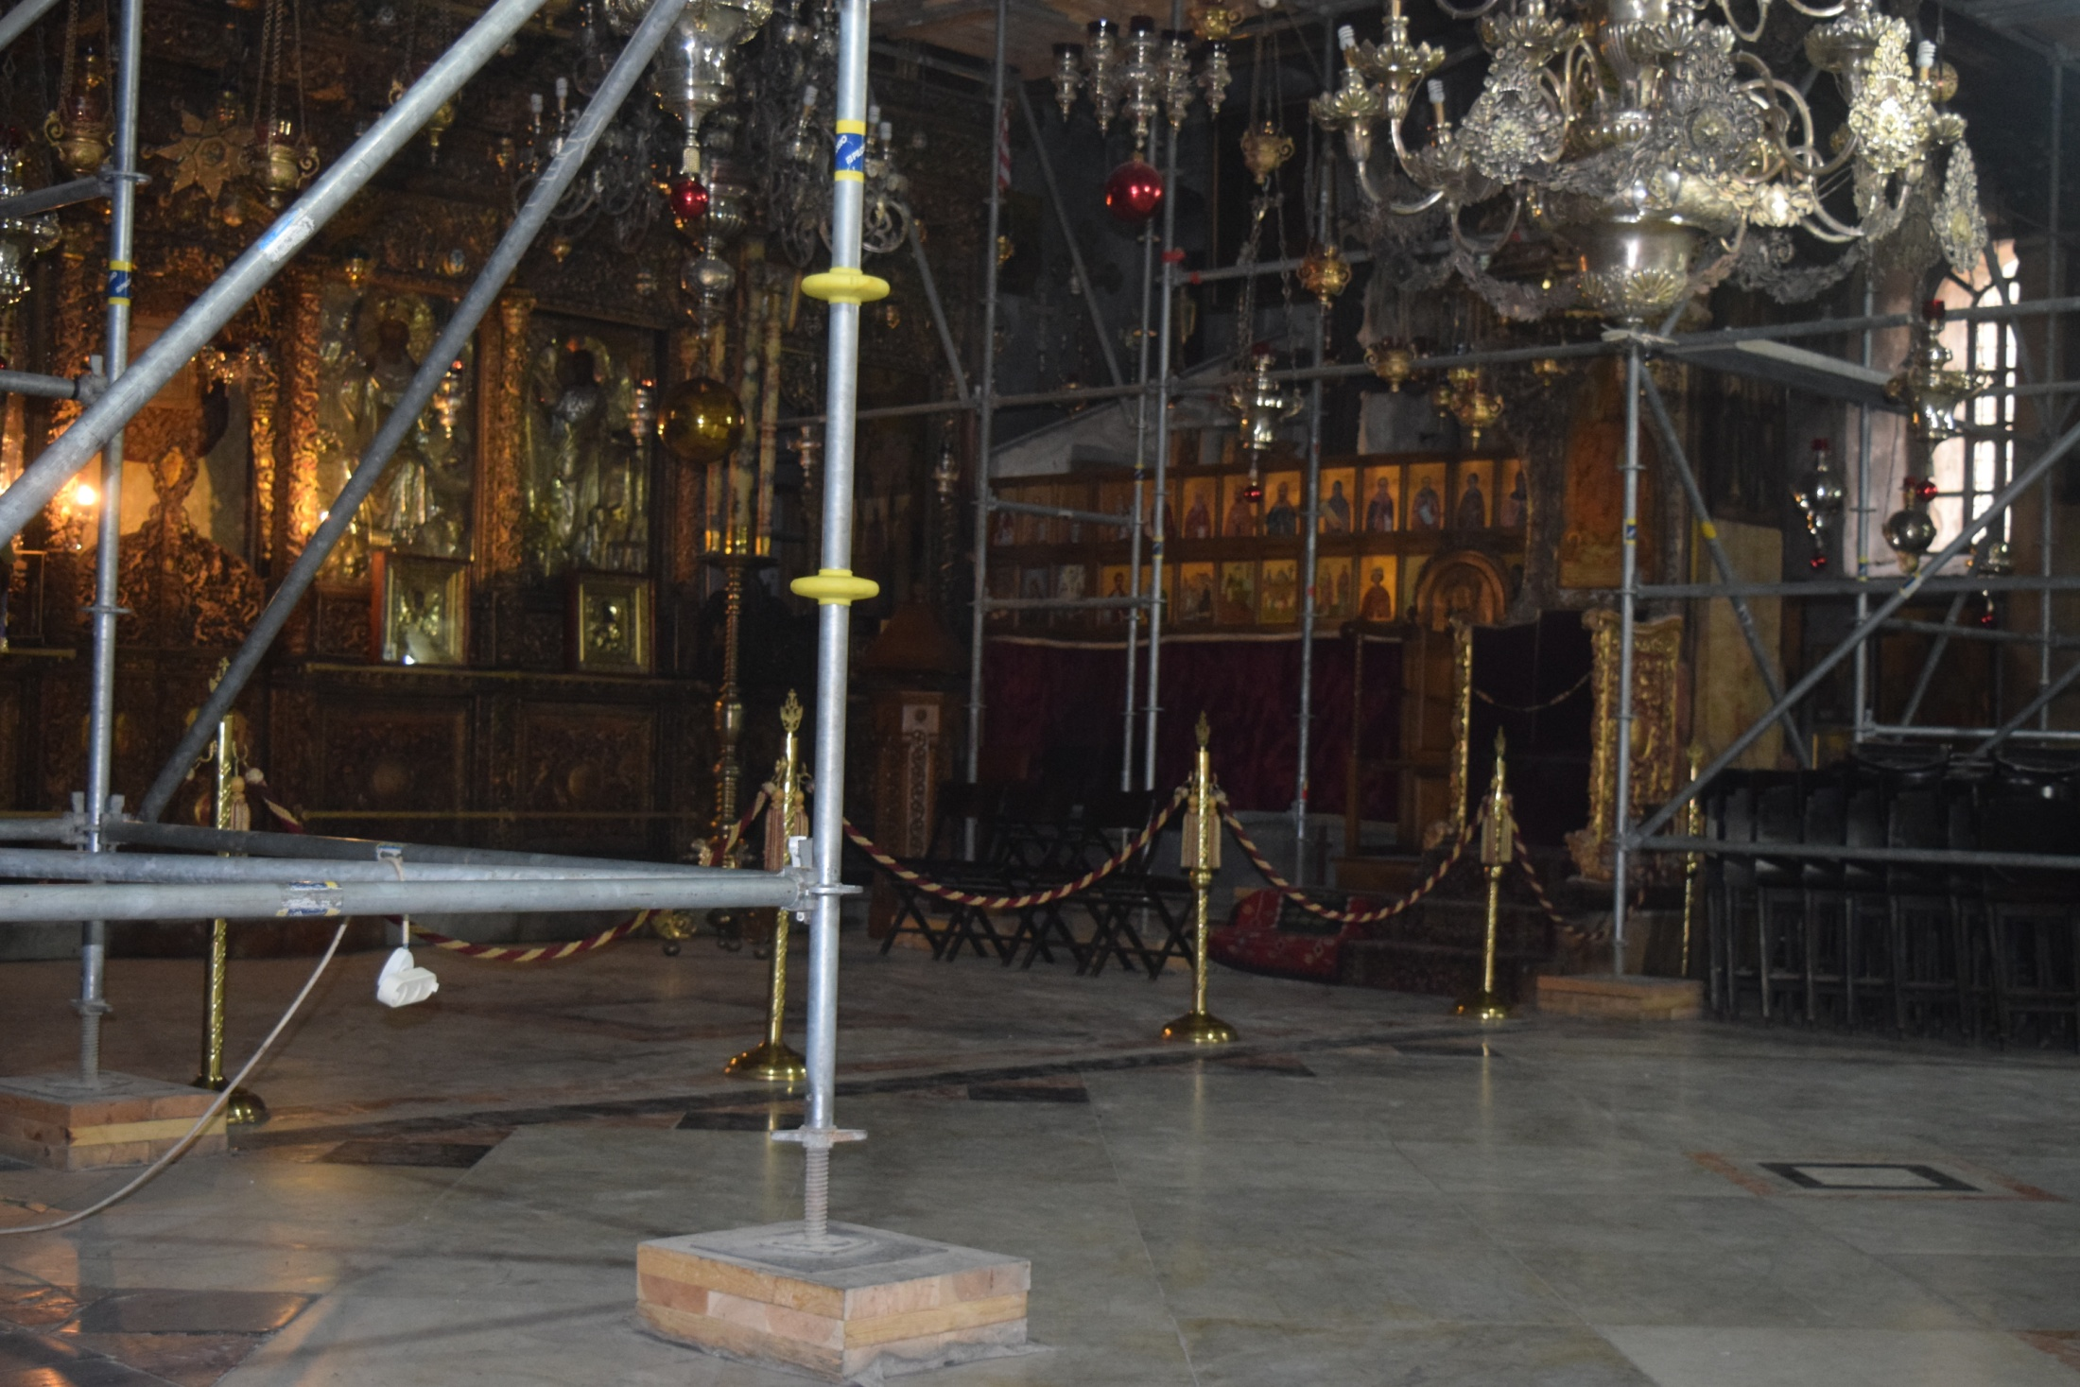

Slide 7
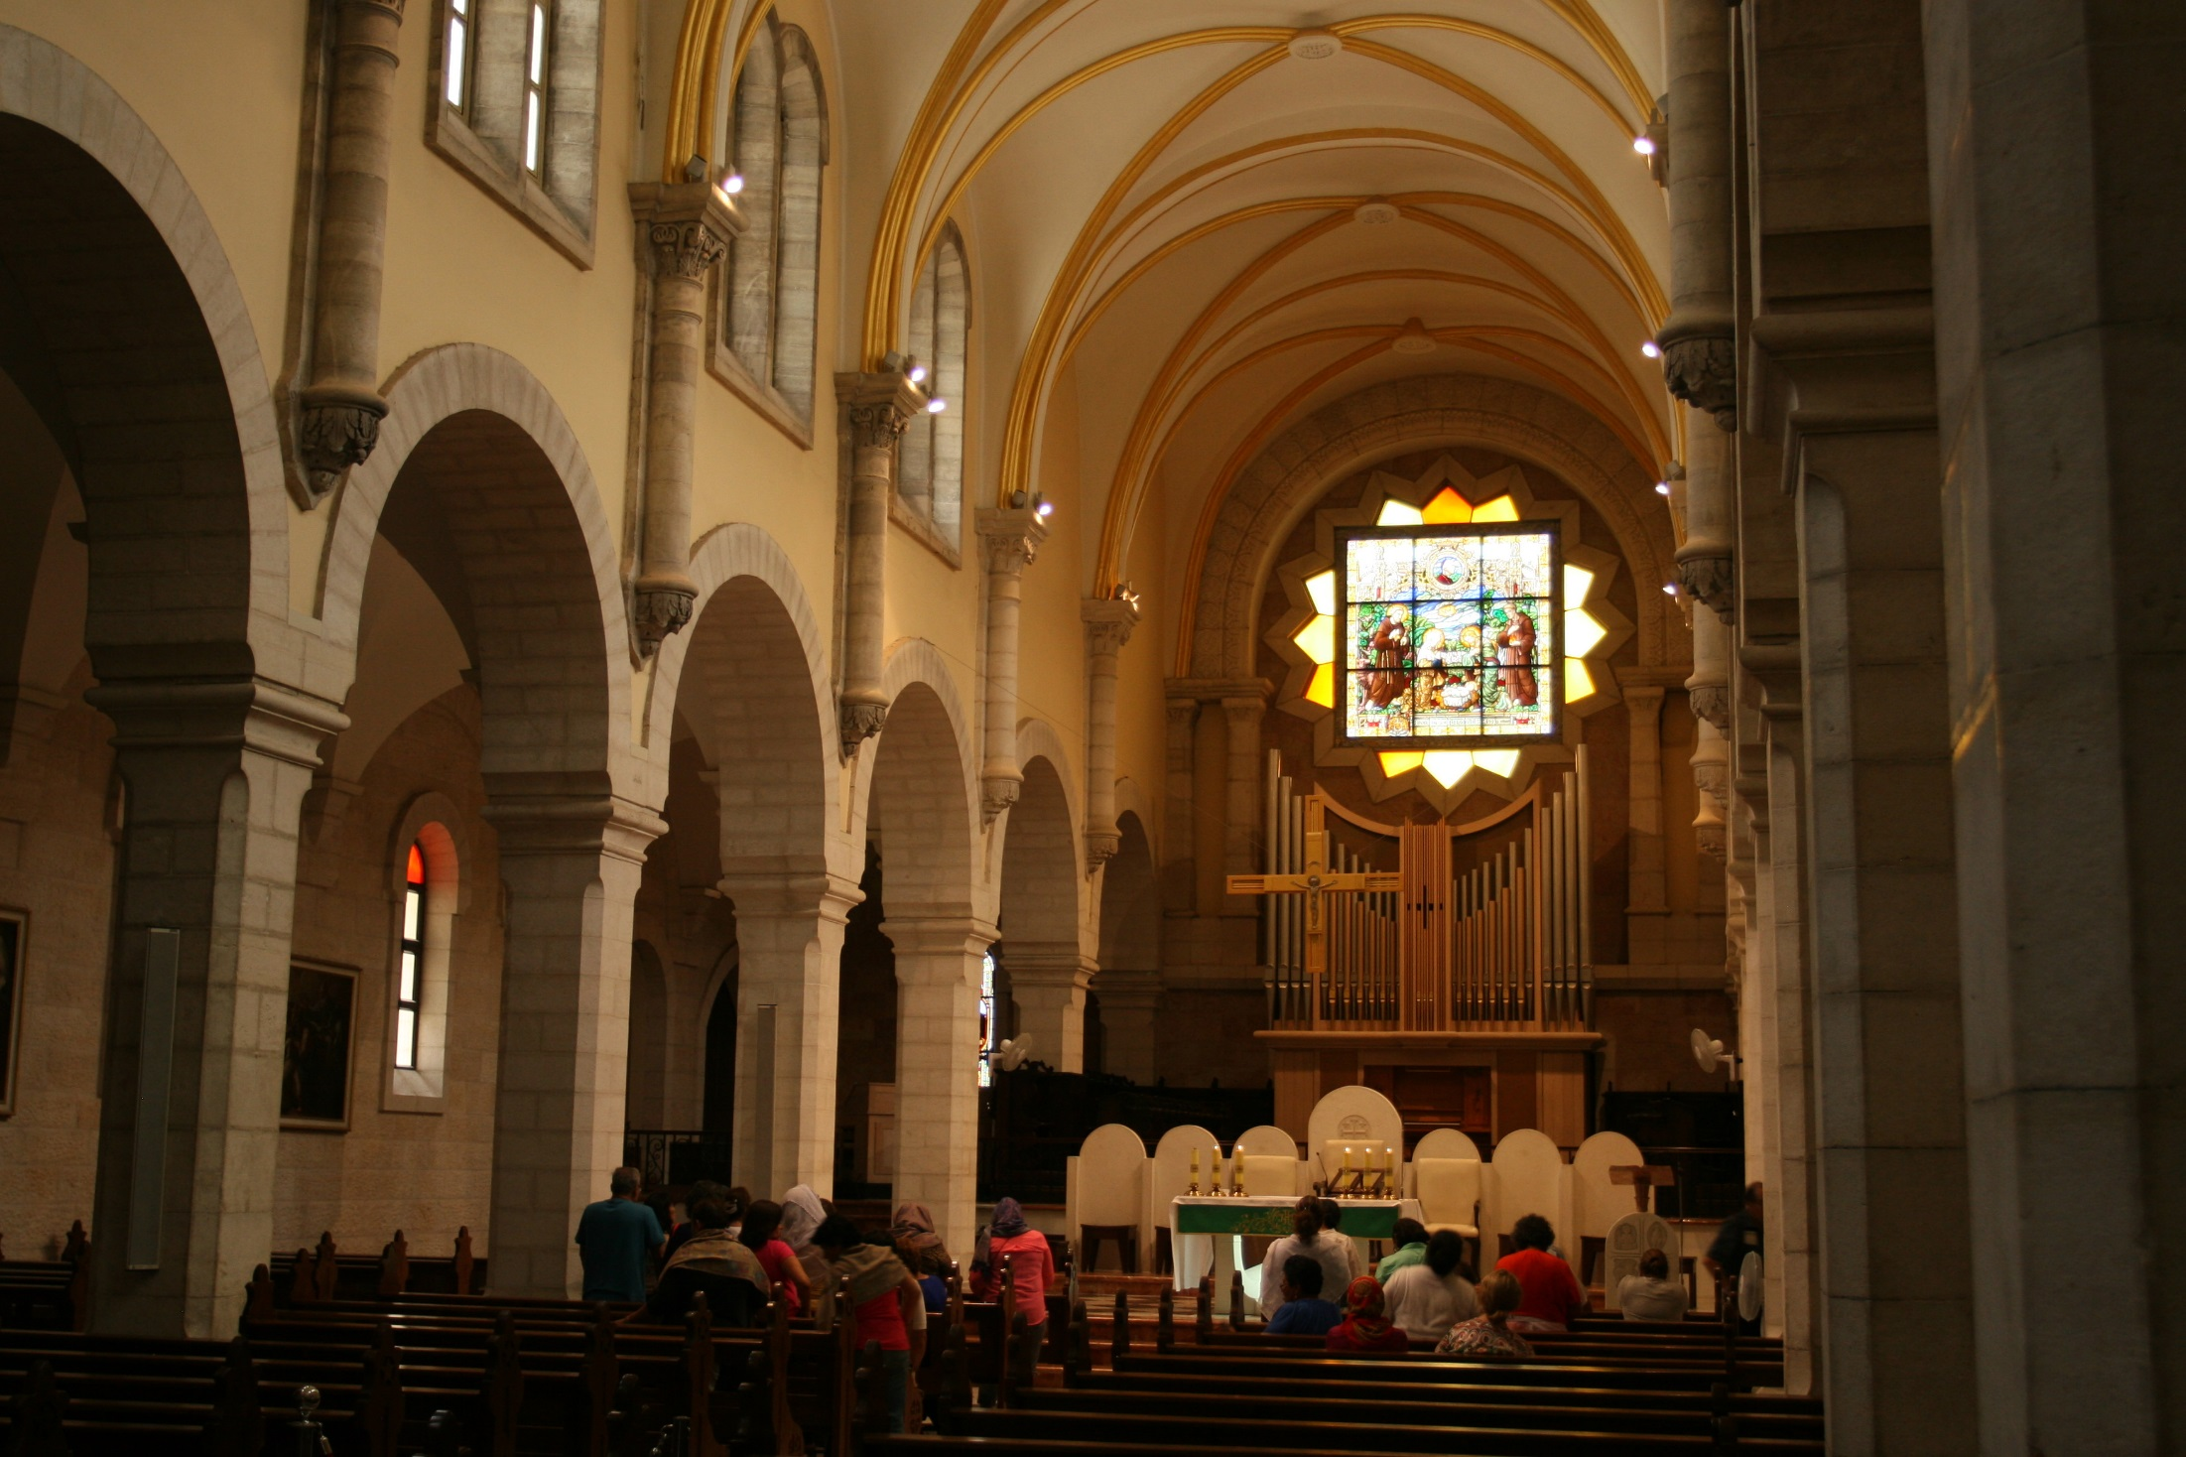

Slide 9
What ties did Jesus have to Bethlehem?
He was born here.
His birth here was accomplished through the providence of God.
His birth occurred during the days of Herod the king.
Magi from the east came to visit Him after His birth.

Slide 10
Jesus of Bethlehem
What can we learn?
Jesus’ birth was special!
He was born of a virgin.
His birth impacts time.
His birth was foretold hundreds of years in advance.

Slide 11
Jesus of Bethlehem
What can we learn?
Jesus’ birth was special!
When seeking truth, get all the facts!
Many people in Jesus’ day missed an opportunity to follow Him because they failed to get all the facts!

