Slide 3
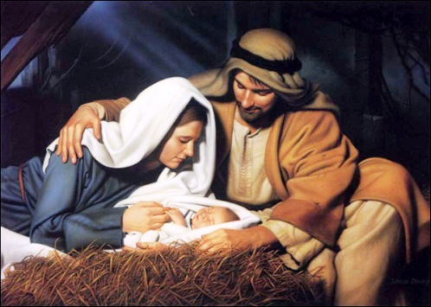

Slide 4
Do you know who the real Jesus is?

Slide 5
Getting to know…
One who got angry (John 2:13-17)
…the real Jesus

Slide 6
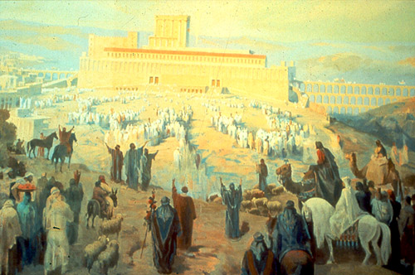
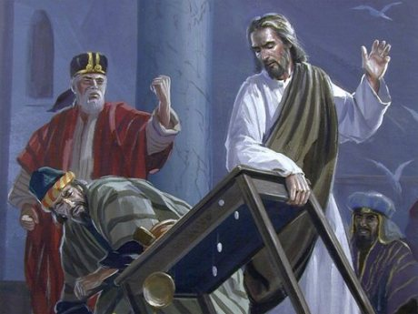
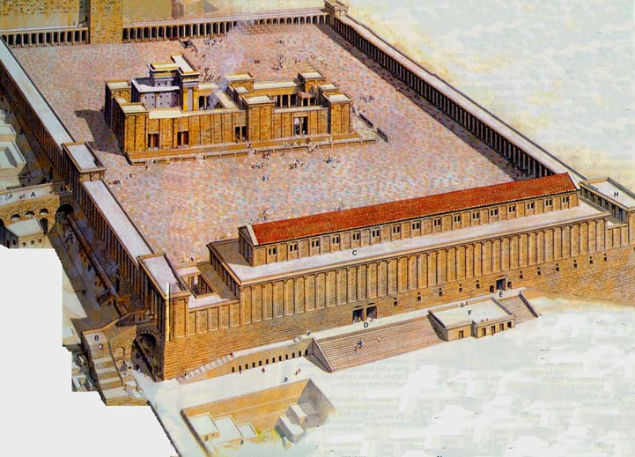

Slide 7
Getting to know…
One who got angry (John 2:13-17)
This challenges us to…
Be angered by sin.
Take action when we see sin being promoted.
…the real Jesus

Slide 8
Getting to know…
One who got angry (John 2:13-17)
One who lamented (John 11:35; Luke 19:41-44)
This challenges us to…
Have feelings towards the sufferings and problems of others.
See people’s most important need in life.
…the real Jesus

Slide 9
Getting to know…
One who got angry (John 2:13-17)
One who lamented (John 11:35; Luke 19:41-44)
One who was in agony (Luke 22:39-44)
This challenges us to…
Understand why Jesus came to the earth.
Deal with our agony in the right way.
…the real Jesus

Slide 10
It is not enough to know Jesus.
We also have to obey Him!

