Slide 1
Bible Reading
Challenge, 2017
Week #2

Slide 2
Jesus of Capernaum
A town that sits on the western shore of the Sea of Galilee.
Name means “Nahum’s town.”
It was a popular fishing town.
It’s location had strategic value to the Romans.
Occupied by Roman soldiers.
It sat on a sloping incline that rose up from the Sea of Galilee.
It was literally a “city set on a hill.”

Slide 3
Jesus of Capernaum
It was the center of Jesus’ ministry.
He took up residence there.
He preached in the synagogue.
He performed several miracles.
Capernaum is still important in Israel today!

Slide 4
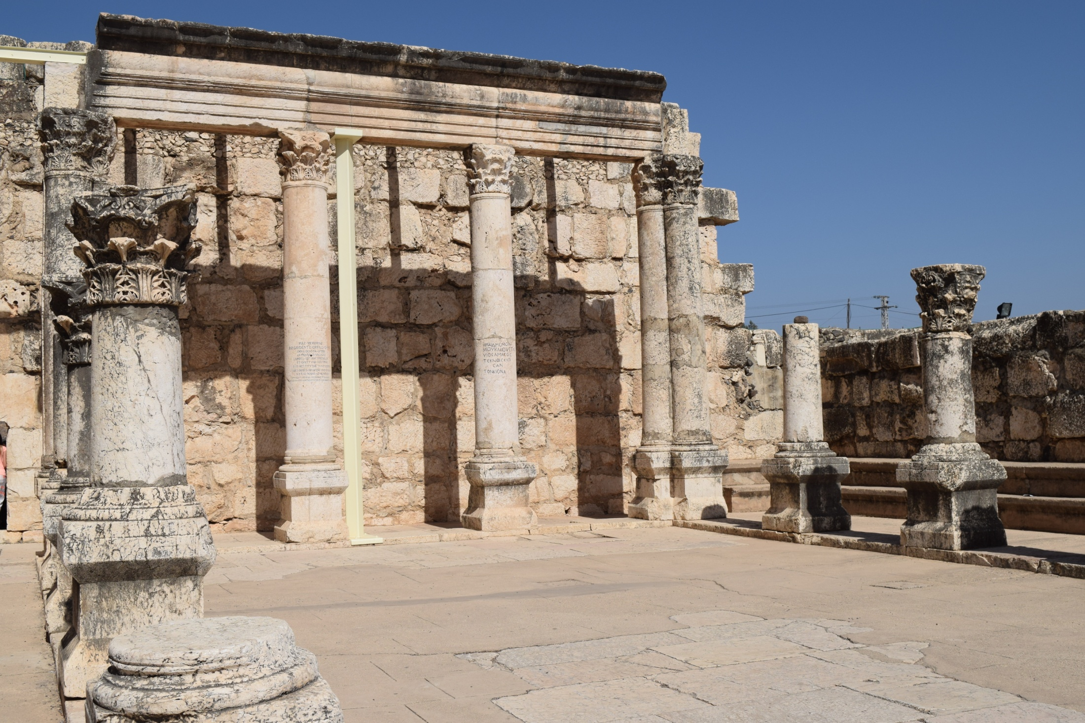
CAPERNAUM

Slide 5
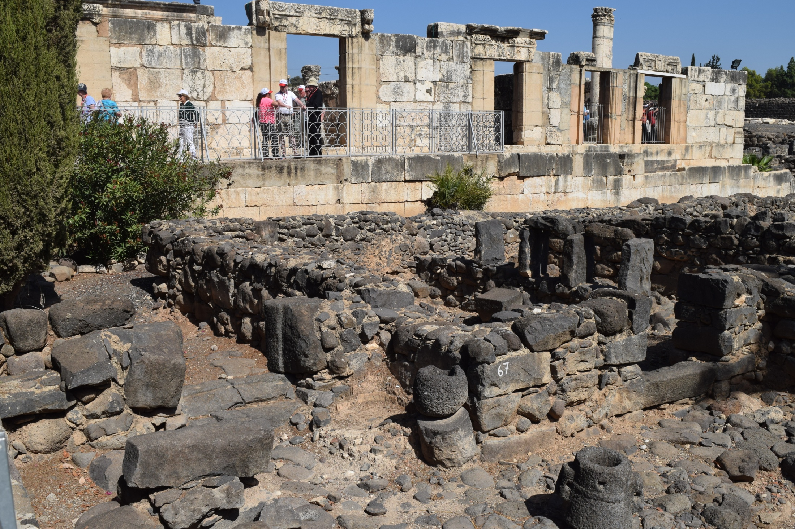
CAPERNAUM

Slide 6
CAPERNAUM
CAPERNAUM

Slide 7
Lessons from Capernaum
Jesus is who He claimed to be!
Preaching the truth causes mixed reactions.
Some accept it and become faithful.
Some merely believe.
Some flat out reject it.

Slide 8
Lessons from Capernaum
Jesus is who He claimed to be!
Preaching the truth causes mixed reactions.
There are serious consequences for rejecting Jesus!
Will we learn from the mistakes made at Capernaum?

