Slide 1
Bible Reading
Challenge, 2017
Week #3

Slide 2
Jesus of Nazareth
It sits 80 miles north of Bethlehem.
It is 15 miles from the western shore of Galilee.
It is 60 miles from the city of Jerusalem.
From it you can see Megiddo and Mount Carmel.

Slide 3
Jesus of Nazareth
It is never mentioned in the Old Testament.
It was considered insignificant in the time of Jesus.
Nazareth has over 75,000 people today.
The majority of people are either Muslim or Jewish.
There are some Catholics.
The only Church of Christ in Israel is here.

Slide 4
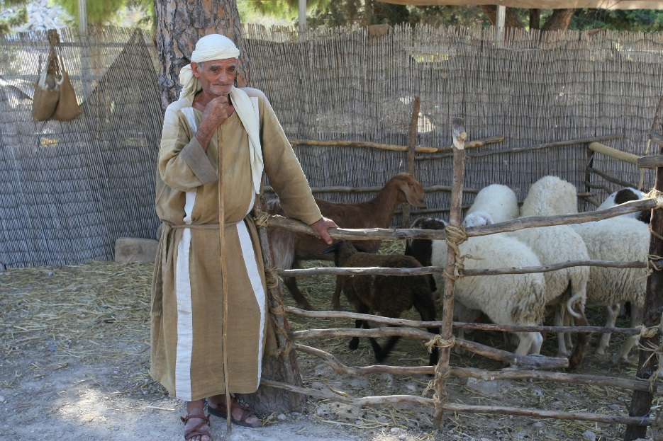
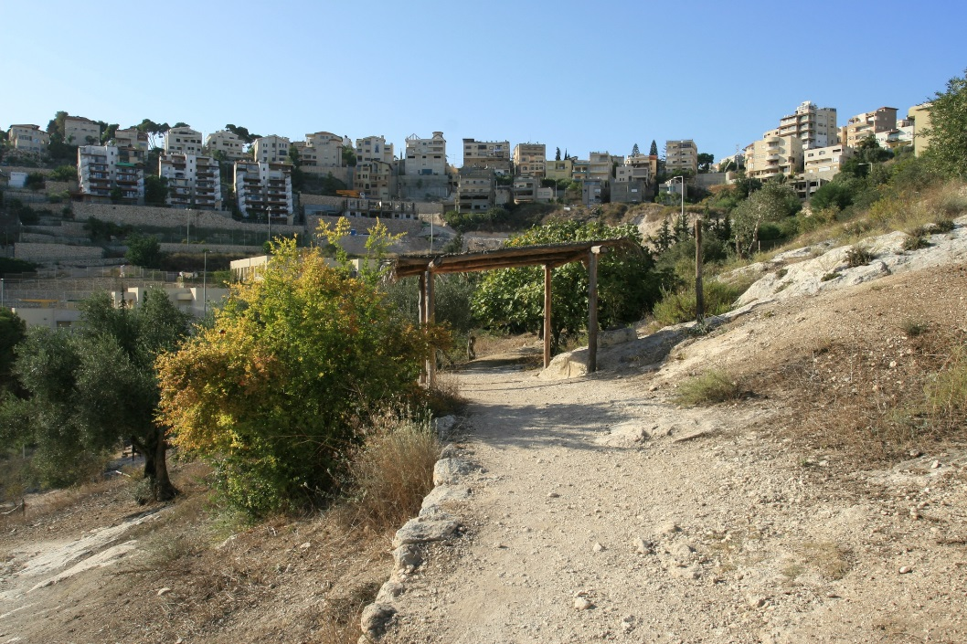
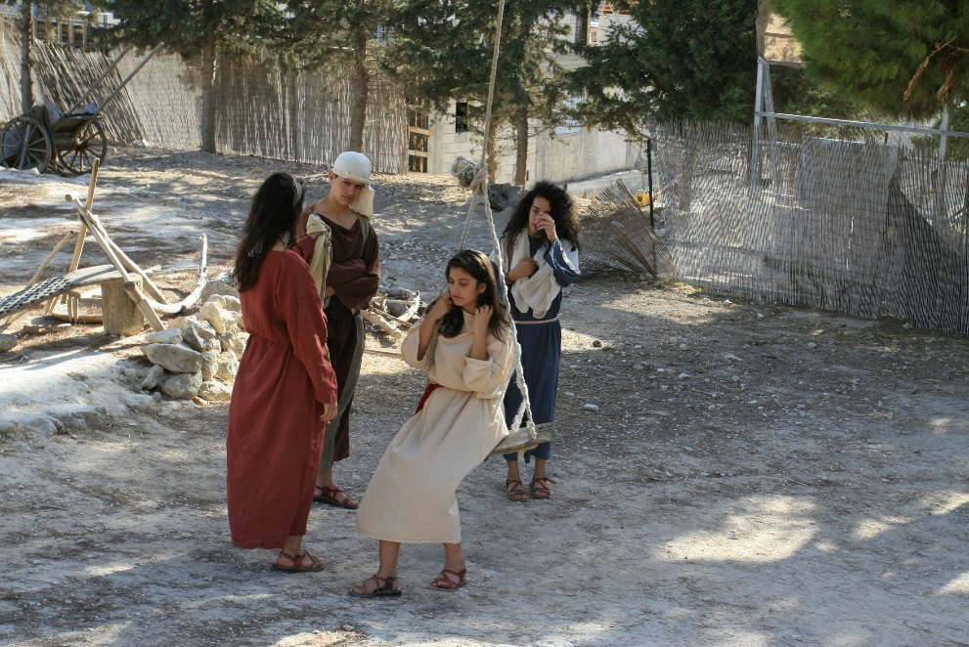
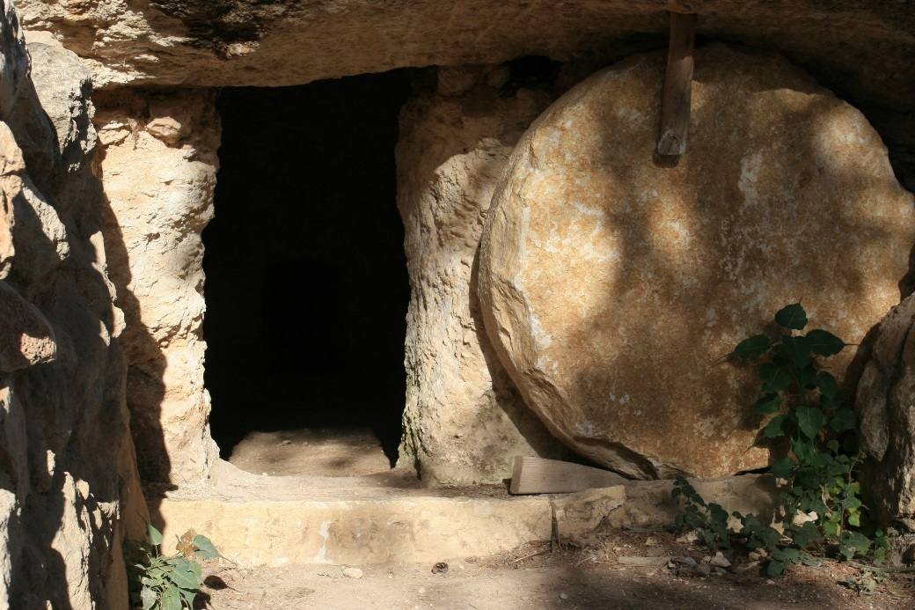

Slide 5
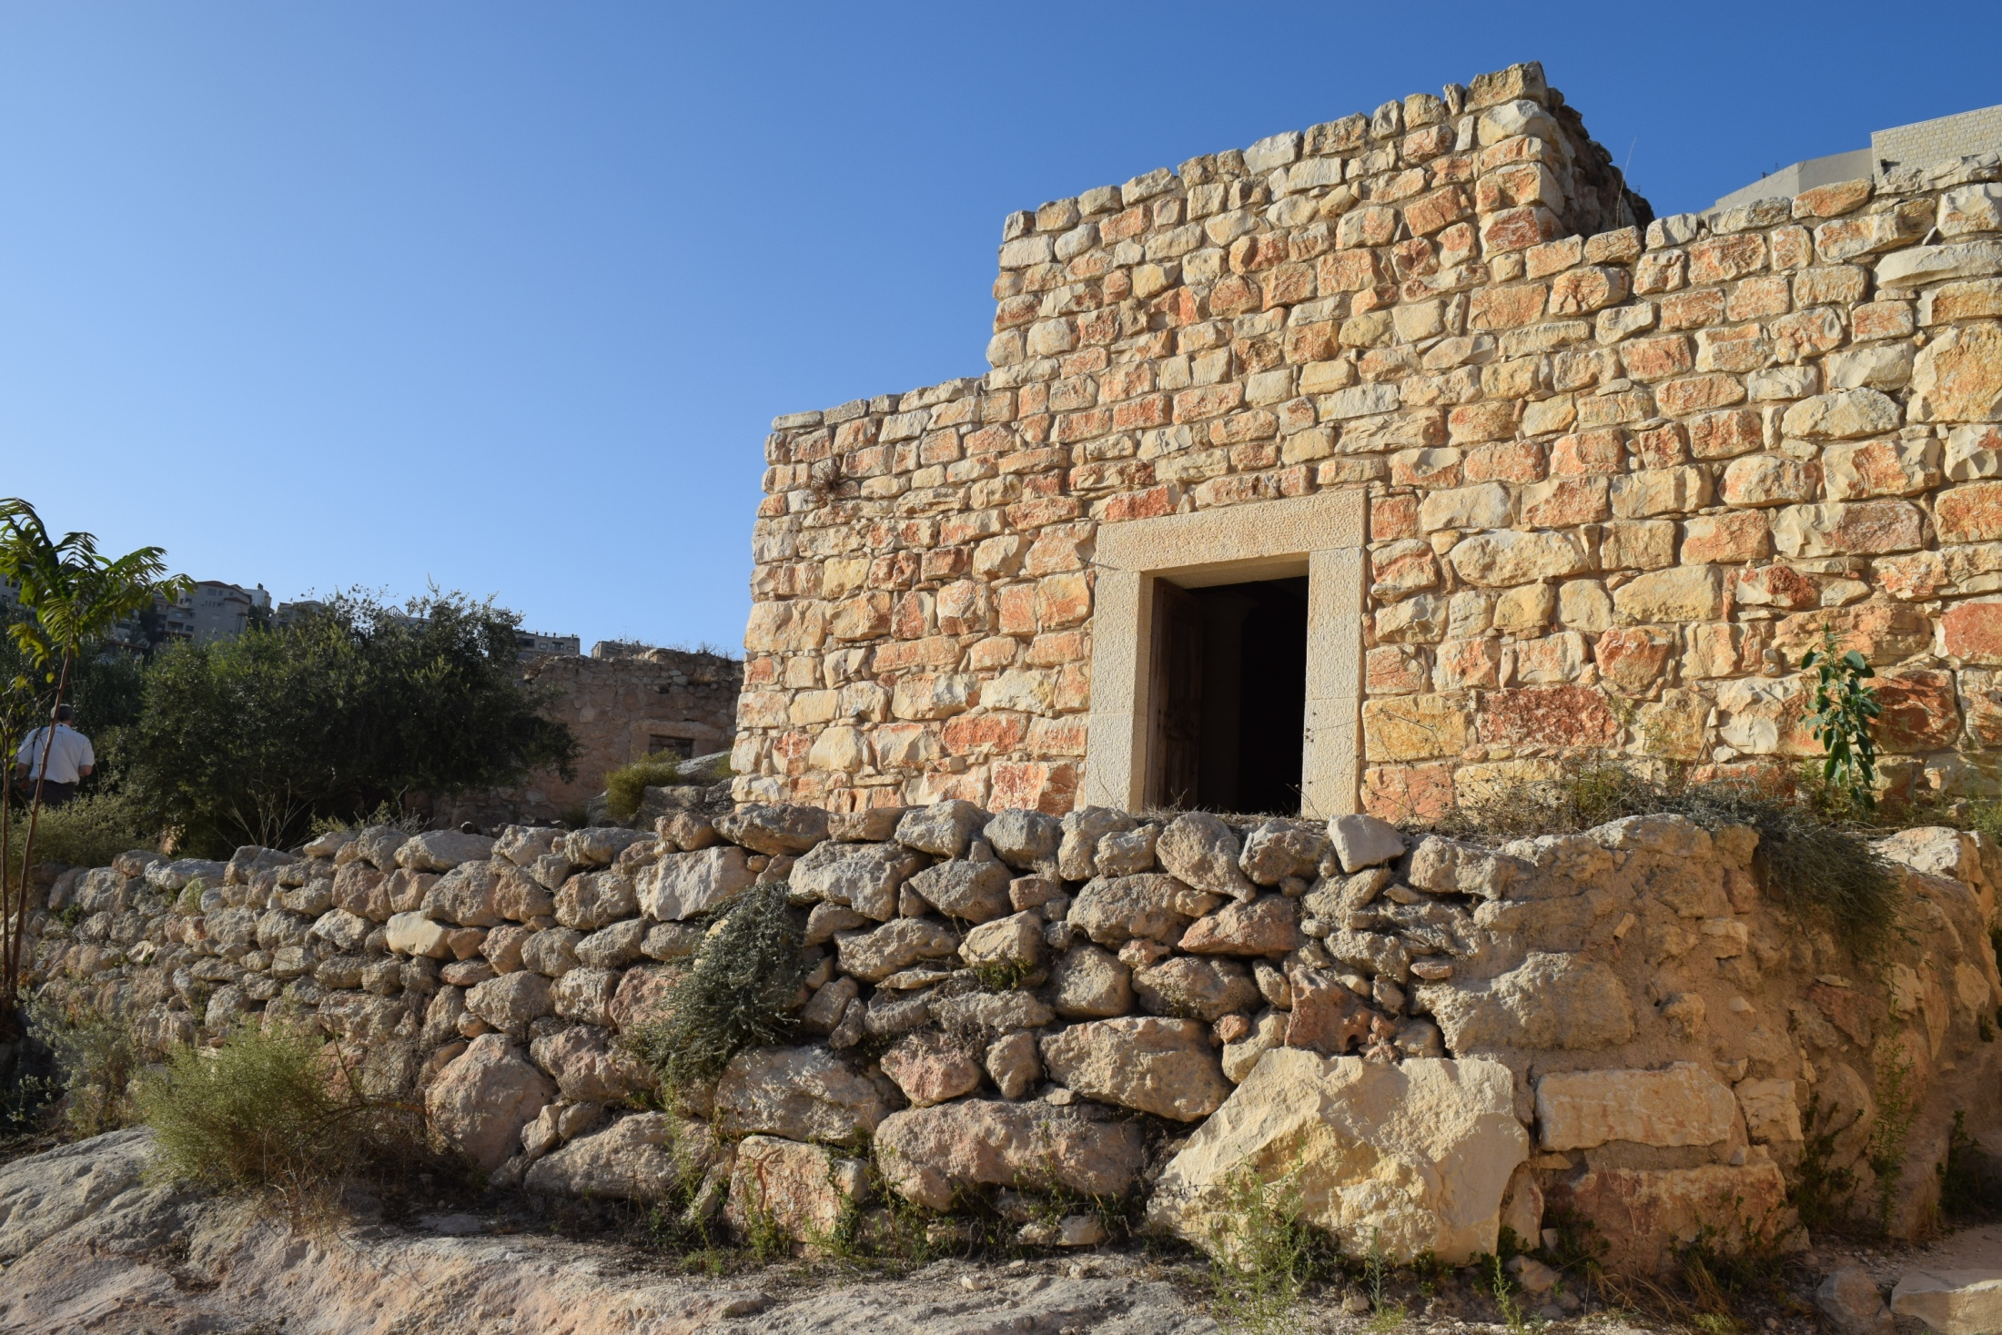

Slide 6
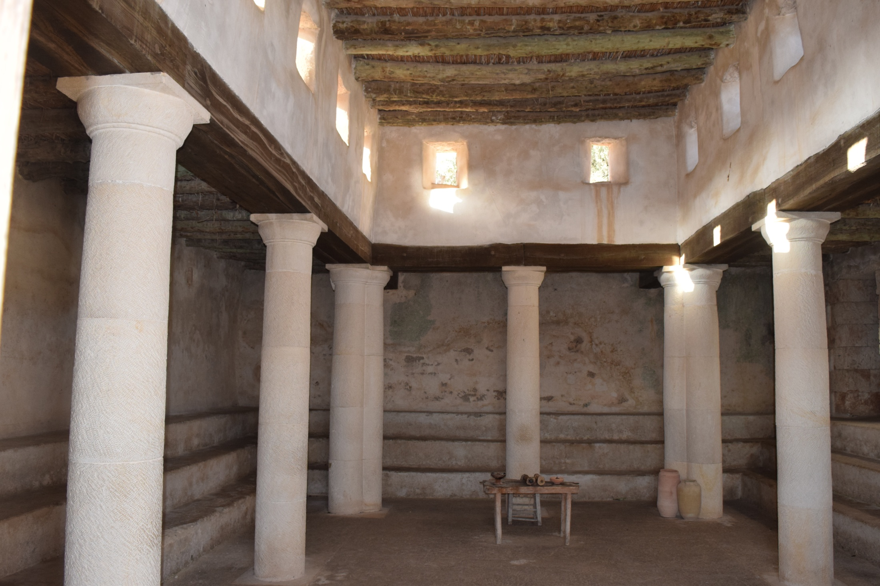

Slide 7
Jesus of Nazareth
What ties did Jesus have to Nazareth?
He grew up here.
He took up carpentry here.
He lived with a big family here.
From here He came to John to be baptized in the Jordan River.
The demons He cast out knew He was from here.

Slide 8
Lesson from Nazareth
A study of Luke 4:14-30
Getting mad at the truth doesn’t change it.
Jesus does not force people to serve Him.
God’s will can never be stopped!

Slide 9
Jesus of Nazareth
He is also Jesus the Son of God!

