Slide 2
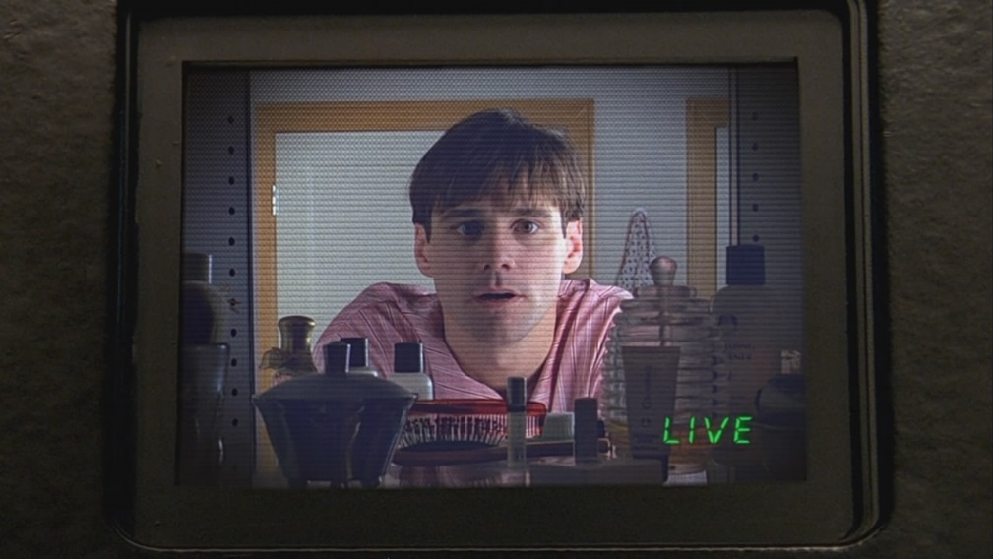
What if your life was like this?

Slide 3
Your Life: A True Reality Show…
…Before God!

Slide 4
Your Life: A True Reality Show…
…Before God!
Clearly Stated
(Psalm 33:13; 139:7-16; Proverbs 5:21; 15:3; Hebrews 4:13)
Biblical Examples
Joseph (Genesis 39:9)
David (2 Samuel 11:26-27)
Jonah (Jonah 1-2)
Ananias and Sapphira (Acts 5:1-11)
The seven churches of Asia (Revelation 2-3)

Slide 5
Your Life: A True Reality Show…
…Before God!
God can see us in our homes!
He sees how we treat our spouse.
He sees how we treat our children.
He sees how we treat our parents.
He sees how we entertain ourselves.

Slide 6
Your Life: A True Reality Show…
…Before God!
God can see us outside our homes!
He sees how we behave at work.
Whatever you do, do your work heartily, as for the Lord rather than for men, knowing that from the Lord you will receive the reward of the inheritance. It is the Lord Christ whom you serve.
- Colossians 3:23-24

Slide 7
Your Life: A True Reality Show…
…Before God!
God can see us outside our homes!
He sees how we behave at work.
The eyes of the Lord are in every place, watching the evil and the good. - Proverbs 15:3

Slide 8
Your Life: A True Reality Show…
…Before God!
God can see us outside our homes!
He sees how we behave at work.
He sees how we behave at school.
The eyes of the Lord are in every place, watching the evil and the good. - Proverbs 15:3

Slide 9
Your Life: A True Reality Show…
…Before God!
God can see the truth about our spiritual lives!
He sees how much we pray.
He sees how much we read and study His word.
He sees where we will be at 5:00 pm today.

Slide 10
Your Life: A True Reality Show…
…Before God!
This reality should motivate us to do two things:
Avoid evil!
Keep doing good!
The eyes of the Lord are in every place, watching the evil and the good. - Proverbs 15:3

Slide 11
Your Life: A True Reality Show…
…Before God!
God will hold us accountable for how we live!

