Slide 2
For 2,000 years men have been trying to predict the end of the world!
Each time they have been wrong!
And as He was sitting on the Mount of Olives, the disciples came to Him privately, saying, “Tell us, when will these things be, and what will be the sign of Your coming, and of the end of the age?”
Matthew 24:3

Slide 3
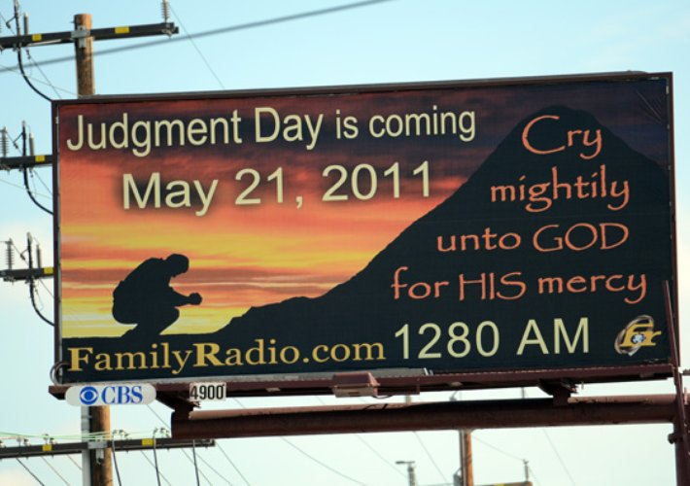
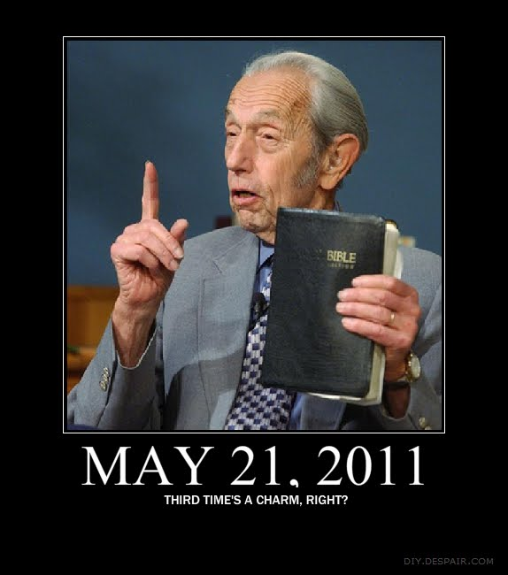
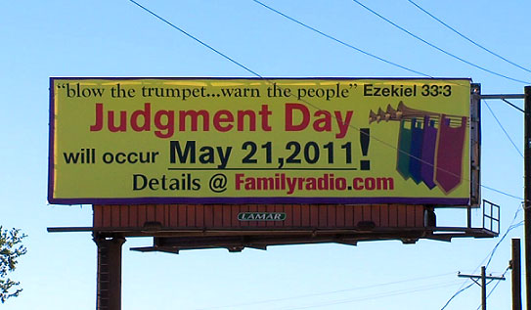

Slide 4
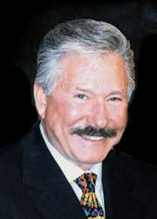
The
Rapture

Slide 5
Jesus is coming back to reign 1,000 years.
Jesus failed the first time He came.
Jesus’ kingdom has not yet been established.
Jesus didn’t come to die for our sins.
Rapture
Christ Returns
Battle of Armageddon
Heaven
Judgment
The Church
The
Great
Tribulation
1,000 Year Reign
Christ Returns
Before… The One Thousand Year Reign
Hell
PRE-MILLENIAL-ISM

Slide 6
What you need to know about the end:
The Lord will come back like a thief (1 Thessalonians 5:2).
There will be no signs to warn us (2 Peter 3:10).
The world will be destroyed (2 Peter 3:10).
All the dead will be raised (1 Thessalonians 4:16).
The faithful will meet Him in the air (1 Thessalonians 4:17).
The judgment will take place (Matthew 25:31-46).
Time will cease, and eternity will begin (Matthew 25:46).

Slide 7
Verses that are misused:
1 Thessalonians 4:15-18
- But the Lord’s return will not be in secret!
2. Matthew 24:40-41
- This is talking about the separation of the righteous and wicked at the end!
3. 1 Corinthians 15:51-54
- More noise and the end of death!

