Slide 2
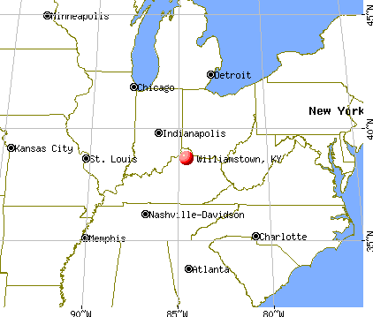
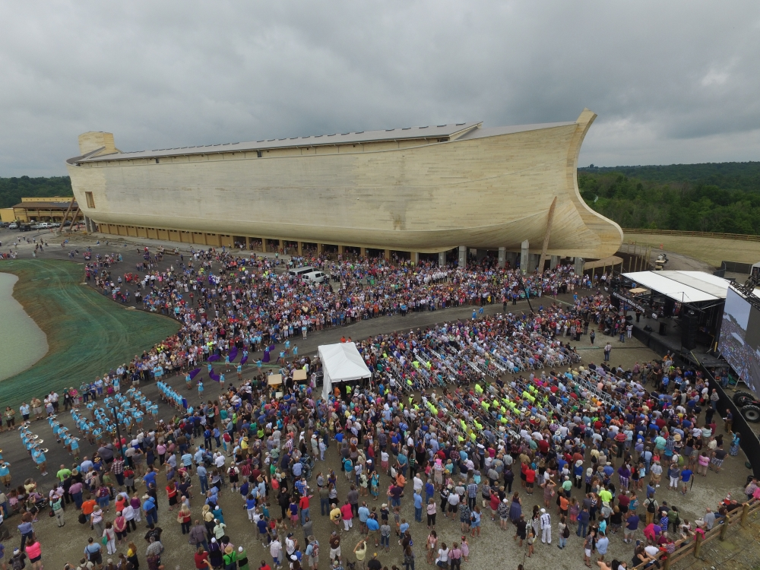
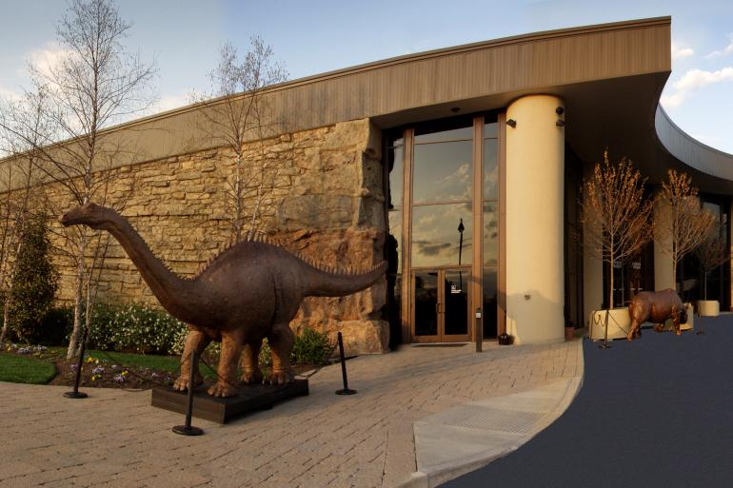
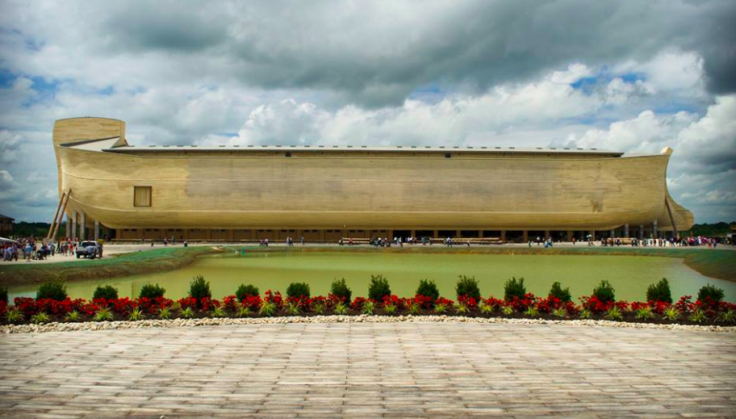

Slide 3
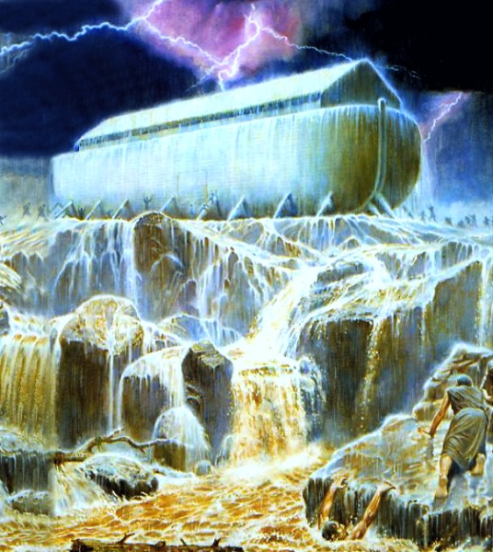
A lesson about preparation (Matthew 24:37)
A lesson about sin (2 Peter 2:4-5)
A lesson about baptism (1 Peter 3:21)
A few lessons about faith (Hebrews 11:7)

Slide 4
Faith That Pleases God
(Hebrews 11:7)
By faith Noah, being warned by God about things not yet seen, in reverence prepared an ark for the salvation of his household, by which he condemned the world, and became an heir of the righteousness which is according to faith.
- Hebrews 11:7
It believes in the unseen.

Slide 5
Faith That Pleases God
(Hebrews 11:7)
By faith Noah, being warned by God about things not yet seen, in reverence prepared an ark for the salvation of his household, by which he condemned the world, and became an heir of the righteousness which is according to faith.
- Hebrews 11:7
It believes in the unseen.
It in reverence obeys God.

Slide 6
“By faith Abel offered to God a better sacrifice (vs. 4).”
“By faith Enoch…was pleasing to God (vs. 5).”
“By faith Noah…in reverence prepared an ark (vs. 7).”
“By faith Abraham…obeyed by going out… (vs. 8).”
“By faith Jacob…blessed each of his sons…(vs 21).”
“By faith Joseph…gave orders concerning his bones (vs. 22).”
“By faith Moses…was hidden for three months by his parents (vs. 23).”
“By faith Moses…refused to be called the son of Pharaoh’s daughter (vs. 24).”
Faith That Pleases God Requires Action
(Hebrews 11)

Slide 7
Faith That Pleases God
(Hebrews 11:7)
By faith Noah, being warned by God about things not yet seen, in reverence prepared an ark for the salvation of his household, by which he condemned the world, and became an heir of the righteousness which is according to faith.
- Hebrews 11:7
It believes in the unseen.
It in reverence obeys God.
It is motivated by love.

Slide 8
Faith That Pleases God
(Hebrews 11:7)
By faith Noah, being warned by God about things not yet seen, in reverence prepared an ark for the salvation of his household, by which he condemned the world, and became an heir of the righteousness which is according to faith.
- Hebrews 11:7
It believes in the unseen.
It in reverence obeys God.
It is motivated by love.
It convicts the world!

Slide 9
Faith That Pleases God
(Hebrews 11:7)
By faith Noah, being warned by God about things not yet seen, in reverence prepared an ark for the salvation of his household, by which he condemned the world, and became an heir of the righteousness which is according to faith.
- Hebrews 11:7
The Final Outcome:
Noah was saved!

